Slide 1

عنوان درس
مدیریت و کنترل پروژه های فناوری اطلاعات(مپفا)
فصل اول ماهیت پروژه های فناوری اطلاعات

Slide 2

پروژه های فا سرمایه گذاری های سازمانی هستند. معمولا سازمان زمان، هزینه و منابع زیادی را برای یک پروژه فا اختصاص میدهد و در ازای آن انتظار دریافت ارزش برای سازمان دارد.

Slide 3

ایا علم مدیریت پروژه مانند یک لباس فری سایز قابل تعمیم به همه دامنه ها هست؟
ایا مدیریت پروژه برای ساخت پل، خانه و موشک با مپفا متفاوت است؟

Slide 4

هدف افزایش موفقیت پروژه با کمک رشته ای نسبتا جدید به نام مپفا
ترکیبی از مدیریت پروژه نوین، مدیریت سیستم های اطلاعاتی، مدیریت نرم افزار، تحلیل و طراحی سیستم برای رسیدن به زیرساختی منطقی و تکرارپذیر جهت افزایش احتمال موفقیت مپفا

Slide 5

مدیریت پروژه
روشی کارآمد برای در نظر گرفتن چالشها و فرصتهای سازمانی
تمرکز مدیریت پروژه بر کاهش هزینه و چرخۀعمرمحصول و ایجاد پیوندی مهم بین استراتژی سازمانی و استقرار آن استراتژی است. این روش منجر به رقابت پذیر سازمان و افزایش سود نهایی می گردد.
Notes:
مدیریت پروژه مدرن اغلب به نیروی دریایی ایالات متحده، با شروع آن، اعتبار داده می شودپروژه موشکی پولاریس به عنوان راهی برای جلوگیری از تهاجم هسته ای احتمالی شوروی در اوایلدهه 1950 پروژه پولاریس پیچیده و پرخطر بود، اما نیروی دریایی از مدیریت پروژه استفاده کردرویکردی برای انتقال پروژه از مفهوم به استقرار. این رویکرد به عنوان یک رویکرد عالی در نظر گرفته شدموفقیت، و سازمان های دیگر در صنایع مختلف شروع به اتخاذ مدیریت پروژه به عنوان یکروشی برای تعریف، مدیریت و اجرای کار برای دستیابی به یک هدف خاص

Slide 6
دوره های استفاده از کامپیوتر برای کسب و کار( ریچارد نولان)
دوره پردازش الکترونیکی داده
دوره مایکرو
دوره شبکه
دوره جهانی شدن
زمینه علمی مدیریت پروژه به موازات فناوری اطلاعات در حال ارتقا بوده است.

Slide 7
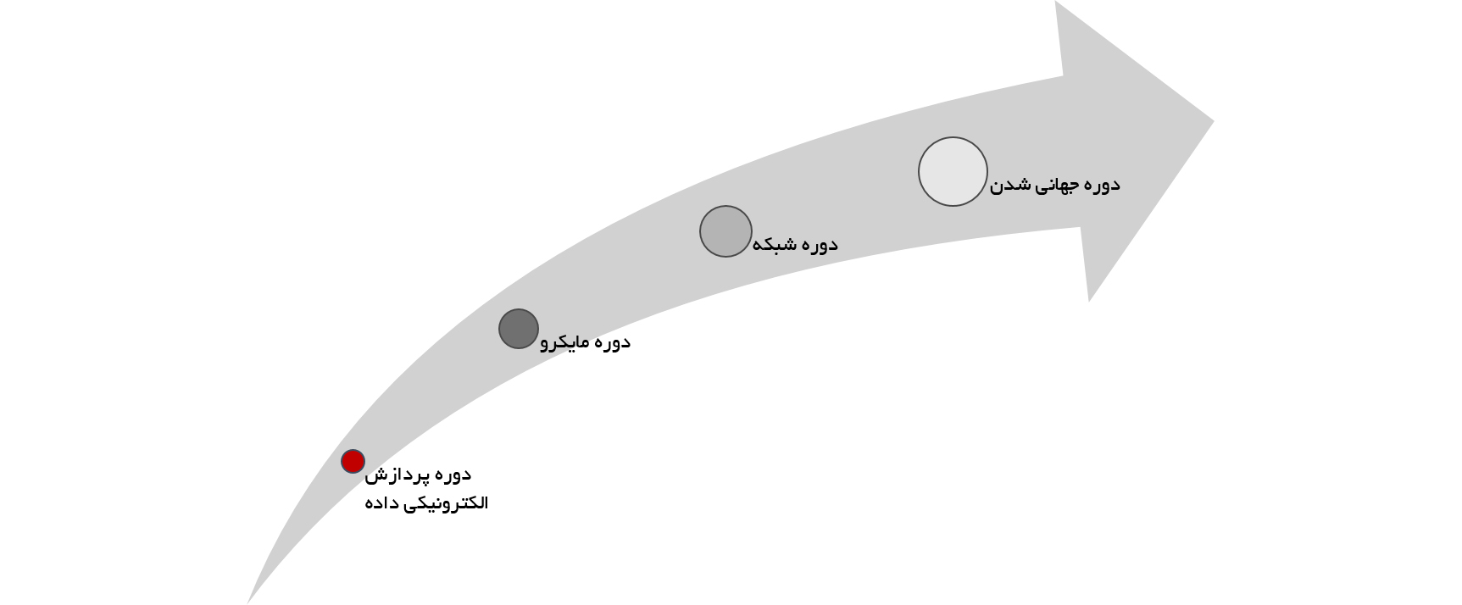

1960 Accounting/ Financial Manager DP Manager
هدف ها:
افزایش بهره وری و کاهش هزینه ها با خودکار کردن بسیاری از فعالیت های دستی و دفتری
نیازمندی های ثابت برای تراکنش های سازمان مانند حسابداری، مدیریت انبارو زمانبندی تولید.
فرآیندهای کسب و کار ثابت
پروژه های ساخت یافته و موازی و در نتیجه روشهای ساخت یافته مپفا
پروژه های چند ساله متداول بودند.
Notes:
EDP : 1960-MainFrames in Org. for financial and accounting -improve efficiency and reduce costs by automating The process remained relatively unchanged, while the means for realizing the process became more efficient-Structures IT Projects-Stable and unchanged requirement and the process accordingly-information silos were created due to
Unfortunately, in many cases these legacy systems created information silos, as projects supported specific business functions that often employed different technology platforms, programming languages, and standards for data.

Slide 8

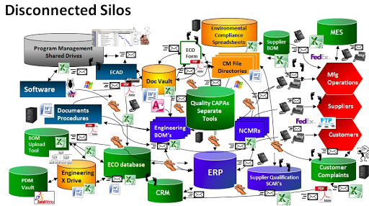
Information silos in workplace: what is, causes, impacts, how to avoid and how to solve?
Notes:
What is An Information Silo in the Workplace? | Definition, Causes, Impacts and How to Avoid
Unfortunately, in many cases these legacy systems created information silos, as projects supported specific business functions that often employed different technology platforms, programming languages, and standards for data.
مثال اسنوا و شهرداری اصفهان

Slide 9
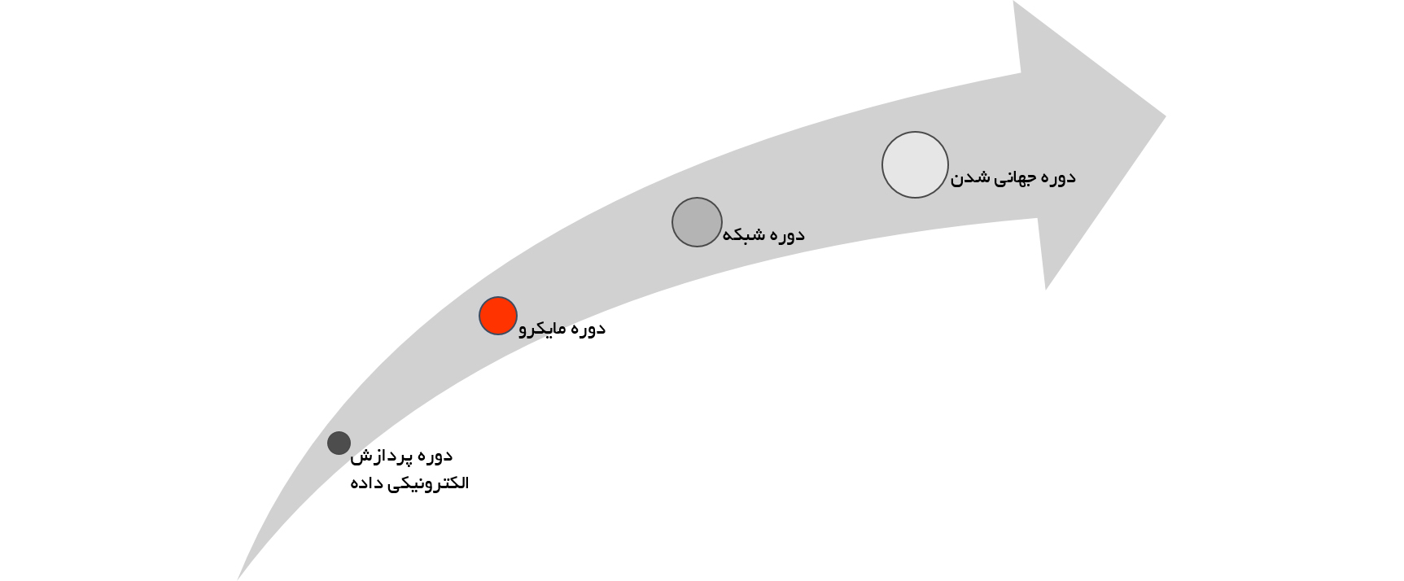
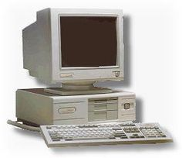
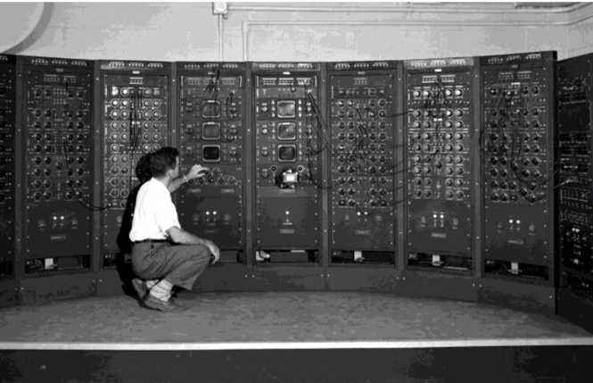
1980 Micro Era
Integrity
Sharing
Standards
Security
Maintenance
Notes:
1980- IBM PC
Shift from Mainfrain to PC→ but not easy
Financial manager authority and buy PC and bypass MIS
This often led to the rise of user-developed, independent systems that replicated data throughout the organization. Security, data integrity, maintenance, training, support, standards, and the sharing of data became a rightful concern. The organization often had an IT resource that was split between a centralized computer and a collection of decentralized user-managed PCs

Slide 10
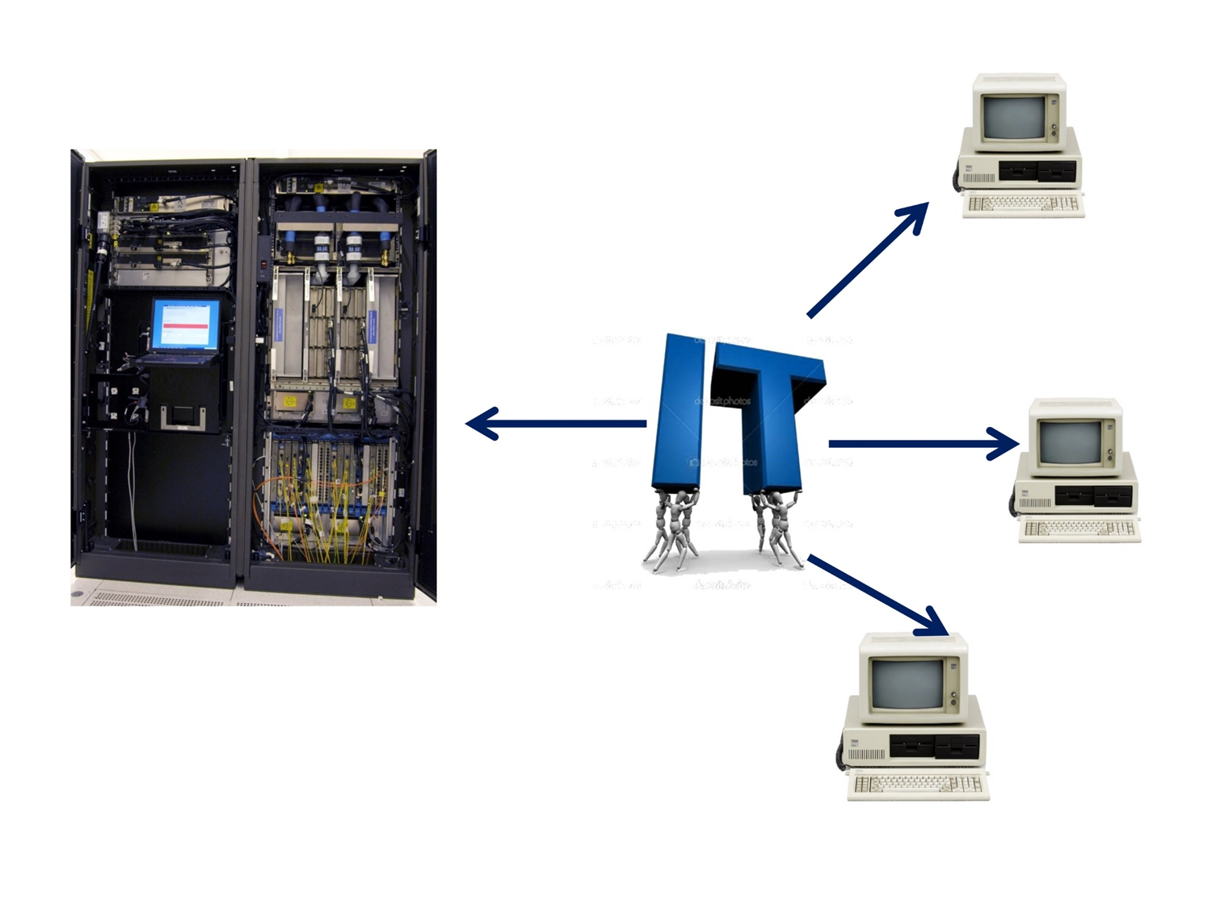
چالش بین مدیریت مرکزی و سیستم های مستقل توسعه یافته توسط کاربران که داده را در بخش های مختلف سازمان جا به جا می کنند.

Slide 11
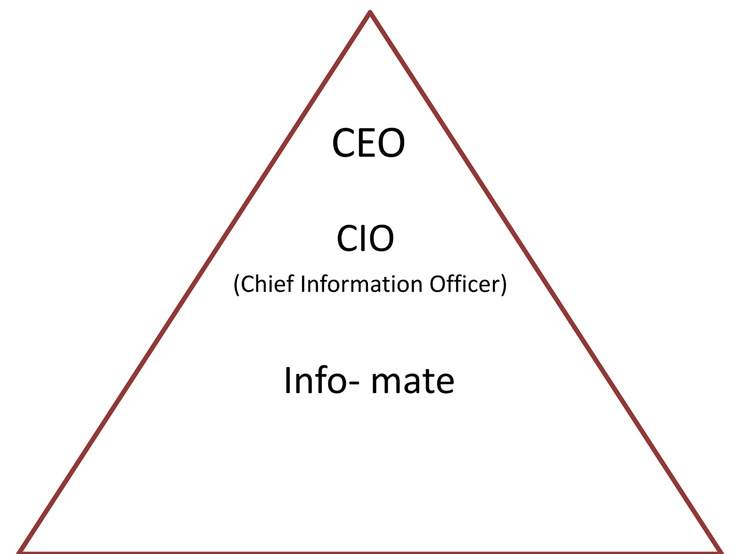
حرکت از ابزاری برای خودکار سازی فرآیندها به سمت ابزاری برای پشتیبانی از کارگران دانش
حرکت کامپیوتر ها در لایه های مختلف سازمان
افق های کوتاه تر پروژه و توسعه نرم افزار و خطر توسعه راهکارهای قدیمی و از کار افتاده فا
Notes:
the role of IT within the organization. While the DP manager often reported to the head accounting or financial manager, the CIO often reported to the chief executive officer (CEO). Therefore, IT increasingly became viewed as more than just a tool for automating low-level transactions and more of a tool for supporting the knowledge worker. Shoshana Zuboff (1988) coined the term “infomate” to describe the role of computers in this era. The computer no longer remained under the direct control of the IT function and its spread throughout the various levels of the organization made IT ubiquitous. IT projects had to take more of an organizational view so that policies, standards, and controls become a part of all systems in order for existing mainframe or minicomputer applications to coexist or integrate with a growing surge of PCs. Moreover, a project manager and team could no longer rely on stable business processes, requirements, or technology that would allow for longer project schedules; otherwise, they would face the risk of implementing an obsolete IT solution. Shorter project horizons that crossed functional lines became the norm, while software development methodologies attempted to shorten the development life cycle

Slide 12
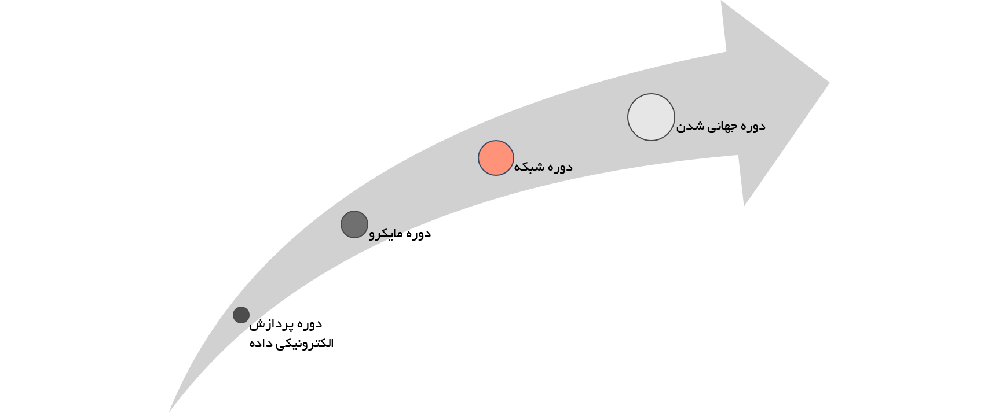
Network Era

Slide 13
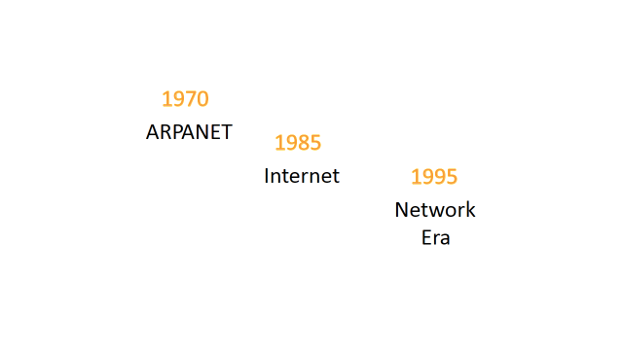

عصر شبکه همگرایی دیجیتالی + فراگیر شدن اینترنت
روش هایی برای ارایه محصولات و خدمات جدید به مشتریان
ساختاری برای حمایت از شرکای تجاری زیاد، همکاری استراتژیک با فروشنده و خریدار و شبکه ای مقیاس پذیر با امکان اتصال کارآمد و بهینه هزاران کامپیوتر
استراتژی های پویا برای کسب و کار و ساختارهای جدید سازمانی
مزایا و خطرهای پروژه های فا شدیدتر از دو دوره قبلی
Notes:
Meanwhile, in the late 1960s and early 1970s, a defense project called ARPANET allowed university researchers and scientists to share information with one another even in the event of a nuclear war. By the mid-1980s, this network of computers became known as the Internet and led to the network era that began around 1995. In the network era, IT projects focused primarily on the challenge of creating an IT infrastructure to support many partners, strategic alliances, vendors, and customers. The network architecture had to be scalable so that potentially thousands of networked computers could function in an efficient and timely manner. Moreover, digital convergence or the integration of data, voice, graphics, and video allowed for new and innovative ways to deliver new products and services to customers. While the micro era focused on creating an internal network within the organization, the thrust of the network era was to extend this network externally. Network era projects not only faced the challenge of coordination and control, but also how to support a dynamic business strategy and new organizational structures. IT project members not only needed to understand the technology, but the organization and its competitive environment. As witnessed by the rise and fall of many dot com businesses in the late 1990s, the benefits and risks of managing IT projects were much higher than the two previous eras

Slide 14

آغاز برون سپاری پروژه ها به دیگر کشورها
Notes:
With the new millennium, IT received a great deal of attention in the media and the boardroom. Some people at the end of the century emptied their bank accounts and stockpiled food and water for fear that computers would crash and civilization would fall into mass confusion. Fortunately, the reported Y2K computer-related problems were few and not too critical. But what made the Y2K problem fascinating was that just about everyone was in it together and the project had an immovable deadline. To fix the Y2K date problem in the millions of lines of code, many organizations took advantage of cheaper wage rates and outsourced the rewriting of its code overseas to such countries as India.

Slide 15
ERP
CRM
E-COMMERCE
Optic fiber
افزایش تقاضا برای نیروهای حرفه ای فناوری اطلاعات
Notes:
After Y2K, it appeared that organizations now had the time and money to start on the IT projects that had been put on hold. Electronic commerce, enterprise resource planning (ERP) and customer relationship management (CRM) systems were at the top of the IT project list for many organizations. Together with large, global investments in fiber optics and the rise of the dot coms, the demand for skilled IT professionals and IT project managers to head up these new initiatives had never been stronger. Recruiters couldn’t hire experienced professionals and university graduates fast enough to meet the demand

Slide 16

Notes:
Unfortunately, this golden time for IT did not last, especially in the United States. The tragic events of September 11, 2001 had a profound impact on the world and the global economy. As a result, many organizations were forced to make some difficult choices in order to survive. Seasoned IT professionals and new graduates who once commanded high salaries and choice assignments found themselves facing a tough job market. The bubble had burst. People learned that things can change quickly and without warning.

Slide 17
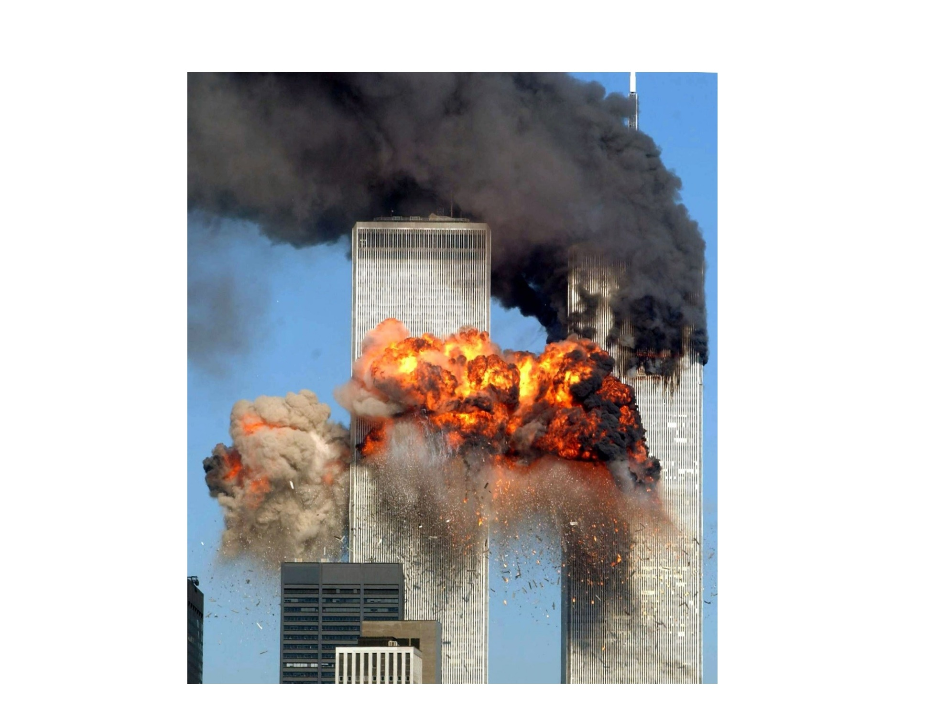

Slide 18
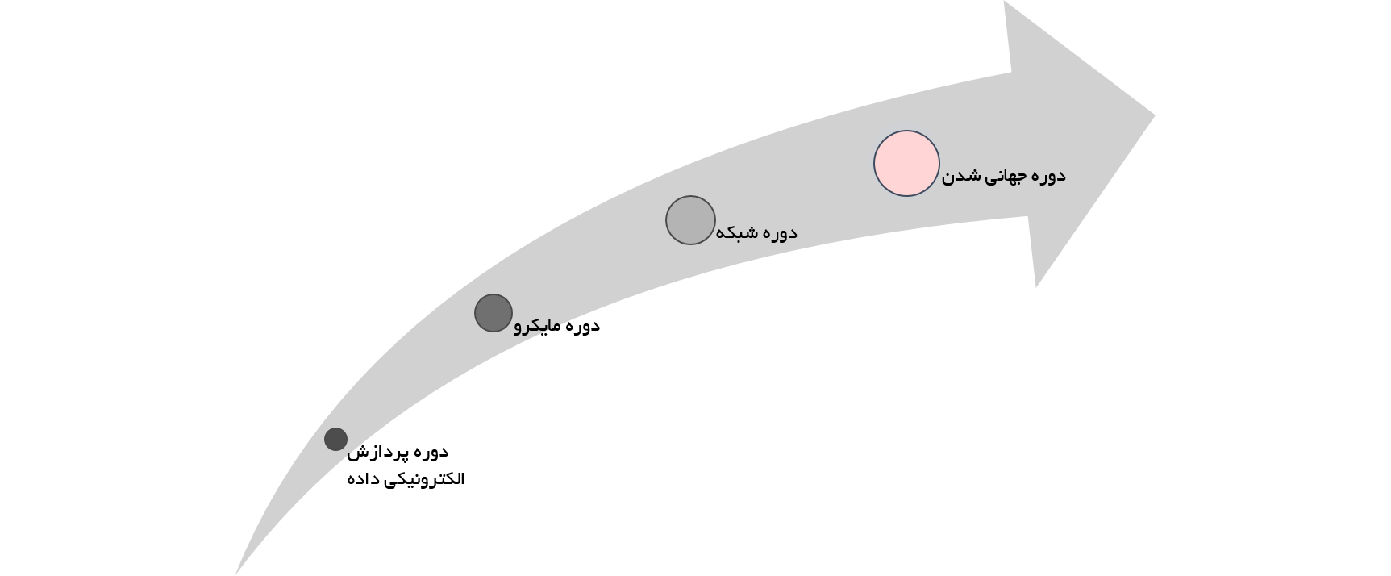
Globalization Era

Slide 19

تاثیر این تغییرات بر مپفا
محیطی پویا
تنوع جغرافیایی
تنوع فرهنگی
شدت ریسک ها و برتری ها
Notes:
What does this mean for you? As a project manager or member of a project team you will be involved in projects that are more dynamic, geographically dispersed, and ethnically or culturally diverse than ever before. The risk and rewards will be greater than the previous eras. Therefore, a solid set of technical, nontechnical, and project management skills founded upon past experience and adapted to this new environment will be needed to manage IT projects successfully.
Example: Trello

Slide 20

سرمایه گذاری بر روی کدام پروژه؟
Notes:
In both good times and bad, senior management will make a certain level of funding available for IT projects. The budgeted amount will depend on such things as the economy, competitors’ actions within the industry, and the organization’s strategic plan. Regardless whether an organization’s budget for IT projects shrinks or grows, the resources available for any given period will be relatively fixed. Quite often the total funding requests for proposed projects will be greater than the available budget. As a result, any project that receives funding will do so at the expense of another project. The competition for funding IT projects proposed by the various business units or departments within an organization will be especially keen when the budget is tight. Projects that do not receive any funding will either have to wait or fall by the wayside. Therefore, the decision to fund a specific project will always be an important management decision because it will have a major impact on the organization’s performance
The decision to fund or invest in an IT project should be based on the value that the completed project will provide the organization. Otherwise, what is the point of spending all that time, effort, and money? Although senior management must make the difficult decision as to which IT projects receive funding and which ones do not, others must plan and carry out the project work. Which situation is worse: successfully building and implementing an information system that provides little or no value to the organization, or failing to implement an information system that could have provided value to the organization, but was developed or managed poorly? It’s probably a moot point: In either situation everyone with a direct or indirect interest in the project’s success loses

Slide 21

هدف ما در این درس:
کمک به طرح ریزی و مدیریت پروژه های فا با استفاده از متد، ابزار، تکنیک و فرآیند برای طرح ریزی و مدیریت پروژه های فا از ابتدا تا انتها
Notes:
The goal of this book is to help you to plan and manage information technology projects. We will focus on a number of different theories, but the main emphasis will be on applying the methods, tools, techniques, and processes for planning and managing an IT project from start to finish. If you are a project manager (or will be one soon), this book will help you to understand and apply project management principles in order to better manage your IT project. If you are just starting out in the field, this book will help you to understand the big picture of what an IT project is all about. This knowledge will help you to become a better team member and prepare you for the next several progressions in your career. Many of the principles of project management can be applied to just about any project, but IT projects are unique in several ways. Throughout the text, we will discuss what makes IT projects different from other types of projects and how the principles and methods of system development can be integrated to define the IT project management discip

Slide 22
وضعیت پروژه های فا

Slide 23
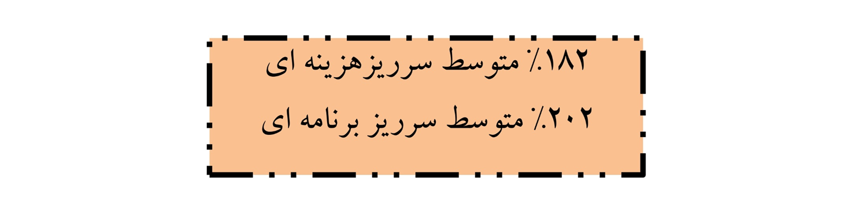
برای یک شرکت با اندازه متوسط

Slide 24
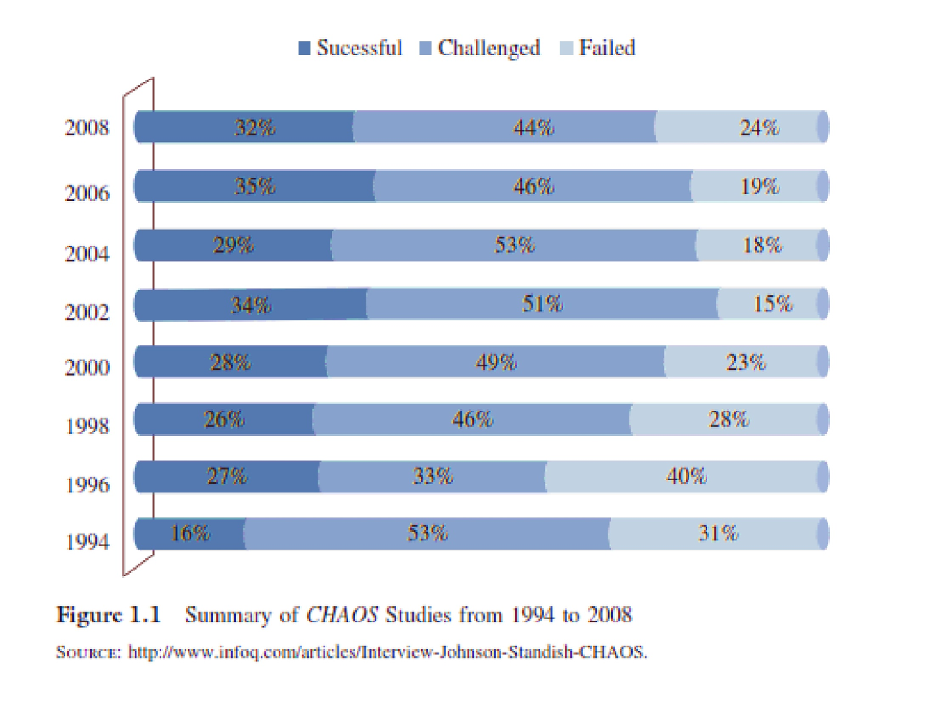
Notes:
re 1.1. Overall, it appears that IT projects are showing a higher success rate. For example, the latest study in 2008 reports that 32 percent of the IT projects were classified as successful in terms of being completed on time, within budget, and including all of the features or requirements envisioned. The Standish Group attributes this continuing improvement to better project management tools and processes, smaller projects, improved communication, more skillful IT project managers, and iterative development.
Interestingly, the CHAOS studies also report factors for successful and unsuccessful projects. Table 1.1 provides a summary of key factors for successful projects for four different time periods. It appears that successful projects have a strong nontechnical component in terms of executive support and user involvement that may lead to clearly defined requirements and project objectives, while the technology, tools, and methods play an important, but lesser, role

Slide 25
Success Factors
Project Management Expertise
Agile process
Optimizing scope
Tools and infrastructure
Skilled resources
Clear business objective
Emotional maturity
Execution
User Involvement
Executive Support
Notes:
The 2010 CHOAS Manifesto describes the most recent factors for project success: ■ User Involvement—Users can be thought of as the project’s customer. Users are important project stakeholders that should be involved in important decisions and because they may have vital knowledge of the business and processes not possessed by the more technical people. Working closely together, the users and developers can better understand the business opportunities and limitations of the technology. ■ Executive Support—The support of upper management is critical in terms of acquiring and maintaining financial backing for the project. Visible support by senior management is also important in terms of emotional support and negotiation or resolution of organizational conflicts. ■ Clear Business Objectives—The project’s stakeholders must focus on the core value of the project. This includes understanding the larger picture of how a particular project supports the business and organizational strategies. ■ Emotional Maturity—Projects are planned organizational change. Emotional maturity focuses on the ability and capability to understand and manage the emotions and actions of the various project stakeholders. This may include the ability to deliver bad news, accept criticism, or dealing rationally with various project challenges. ■ Optimization—The optimization of information technology centers making systems, processes, and people efficient and effective as possible in order to provide the highest level of value to the organization. For example, an information system should include only those feature and functions that help the users perform their job. Including extra functionality that the user doesn’t need or didn’t ask for is not optimal. ■ Agile Process—An agile process supports the user/developer relationship by encouraging team work, collaboration, and evolving requirements, while allowing for rapid delivery. ■ Project Management Expertise—Project managers must be skilled in both project management knowledge and the organizational environment. On the other hand, the organization must recognize and give support to the project manager and his/her expertise. ■ Skilled Resources—To be successful, a project manager must be able to acquire, manage, and control the right resources at the right time. This may include the ability to develop people or replace a key project
Execution—Projects are executed or carried out according to a plan. This first requires developing a realistic plan, but also requires leadership and project management knowledge and expertise for a successful outcome. ■ Tools and Infrastructure—This means having the right tool for job, but also having the skill to use that tool properly. Tools, such as Microsoft Project®, are useful for planning, managing, and communicating the progress of a project, but by themselves will not make a project successful. Tools and infrastructure must support the project management processes.

Slide 26
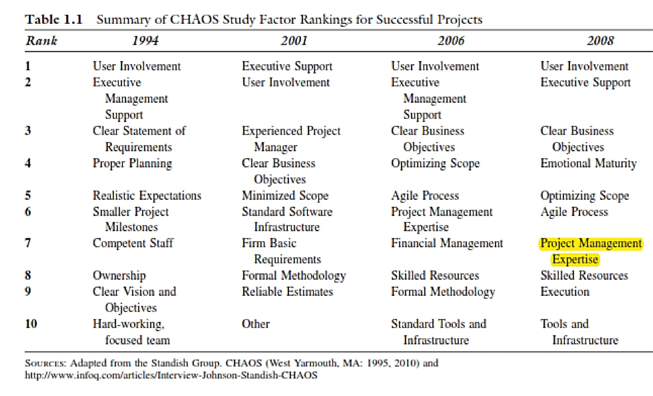

Slide 27
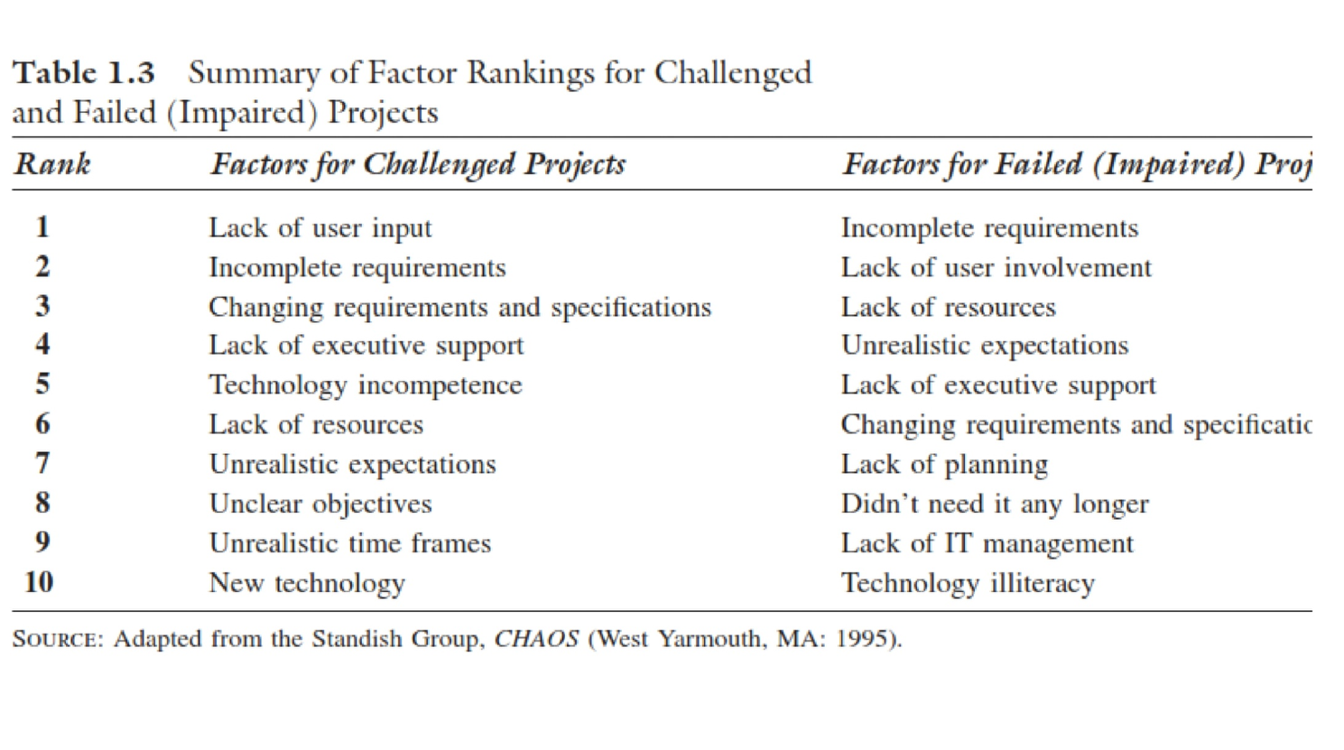
Notes:
Table 1.3 summarizes the project factors for not-so-successful projects to see what might be happening. Lack of user input or involvement ranks at or near the top in factors listed under challenged or failed (impaired) projects. One can almost picture that chain of events. Without close support of key users, the team will have a difficult time understanding and defining the requirements of the project. As a result, suspicion and conflicts may arise, and there can easily be an “us versus them” situation between the developers and the users. Without effective communication and a clear direction, changes to the project’s requirements always seem to appear, and both the users and developers may set unrealistic expectations. Management then begins to find fewer reasons to support an unpopular project, and more and more resources may be diverted from it. The project is barely successful, if not a failure.

Slide 28
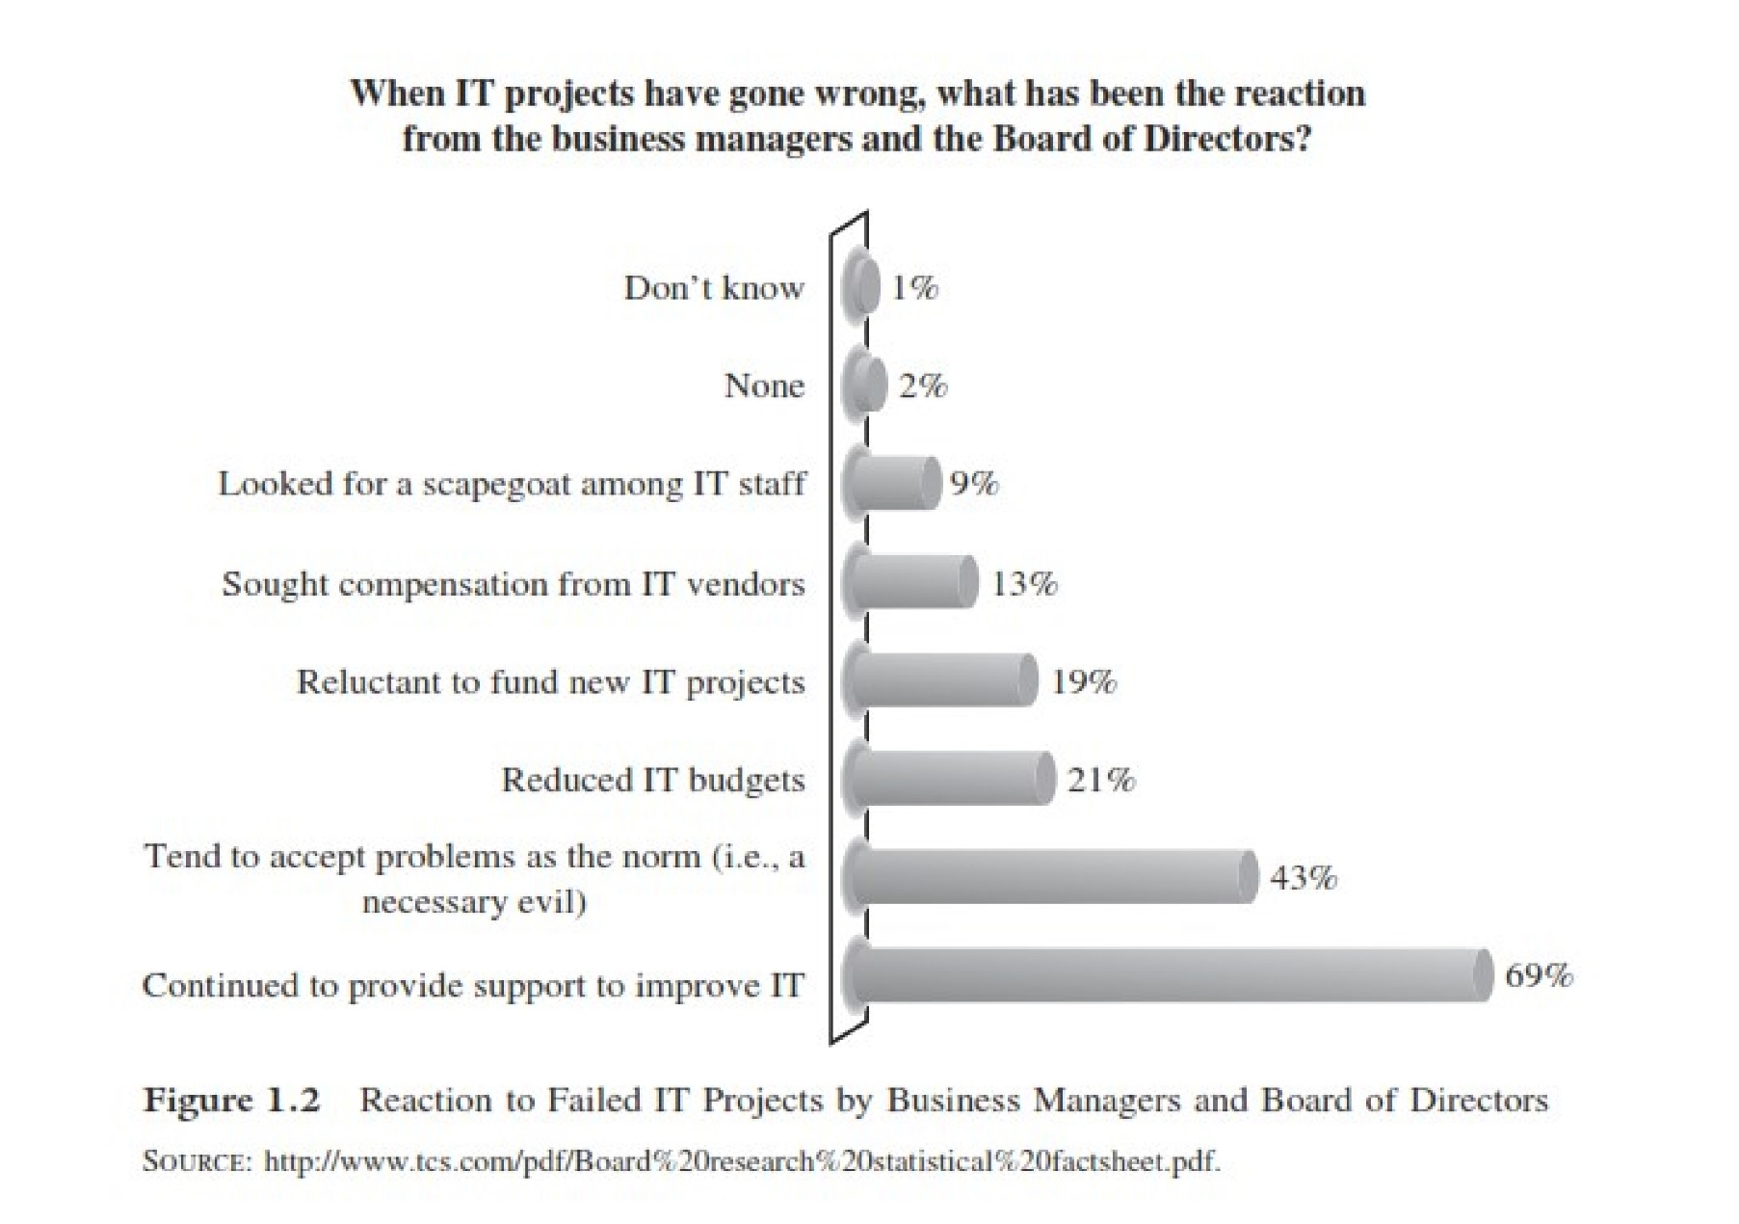
خبر خوب این که در اغلب موارد شکست پروژه فا منجر به عدم حمایت نشده است

Slide 29
CHAOS 2016 and 2020 report
Success, Failure Reasons of ITPM in Iran

Slide 30
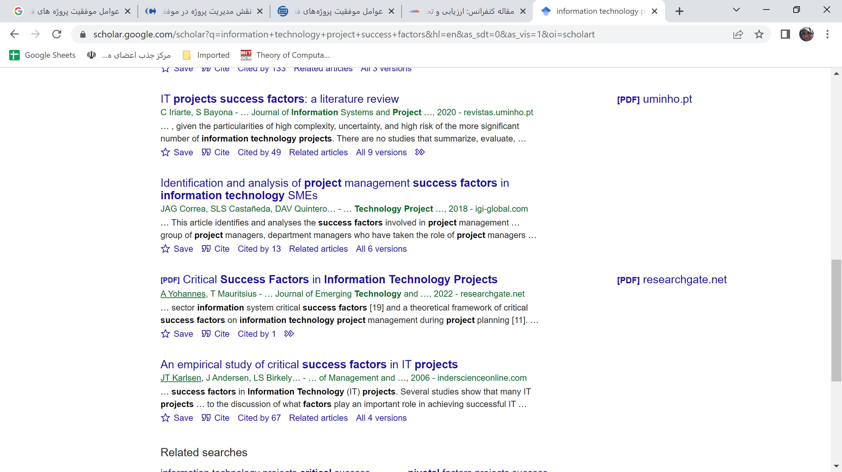
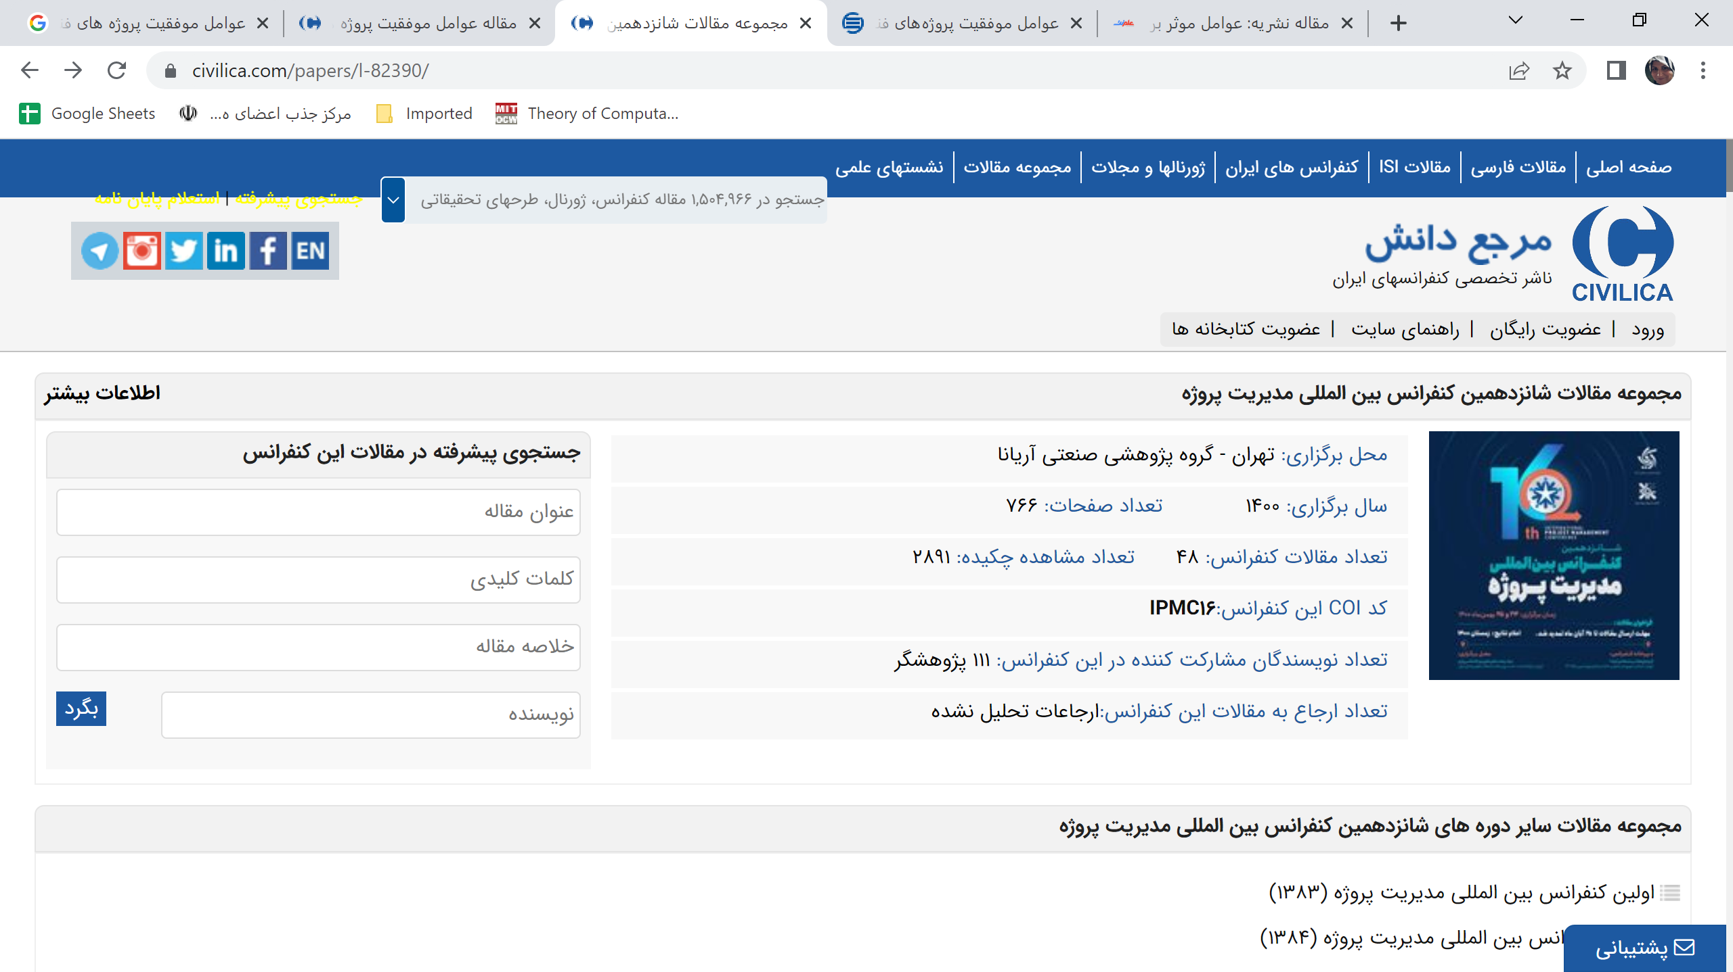
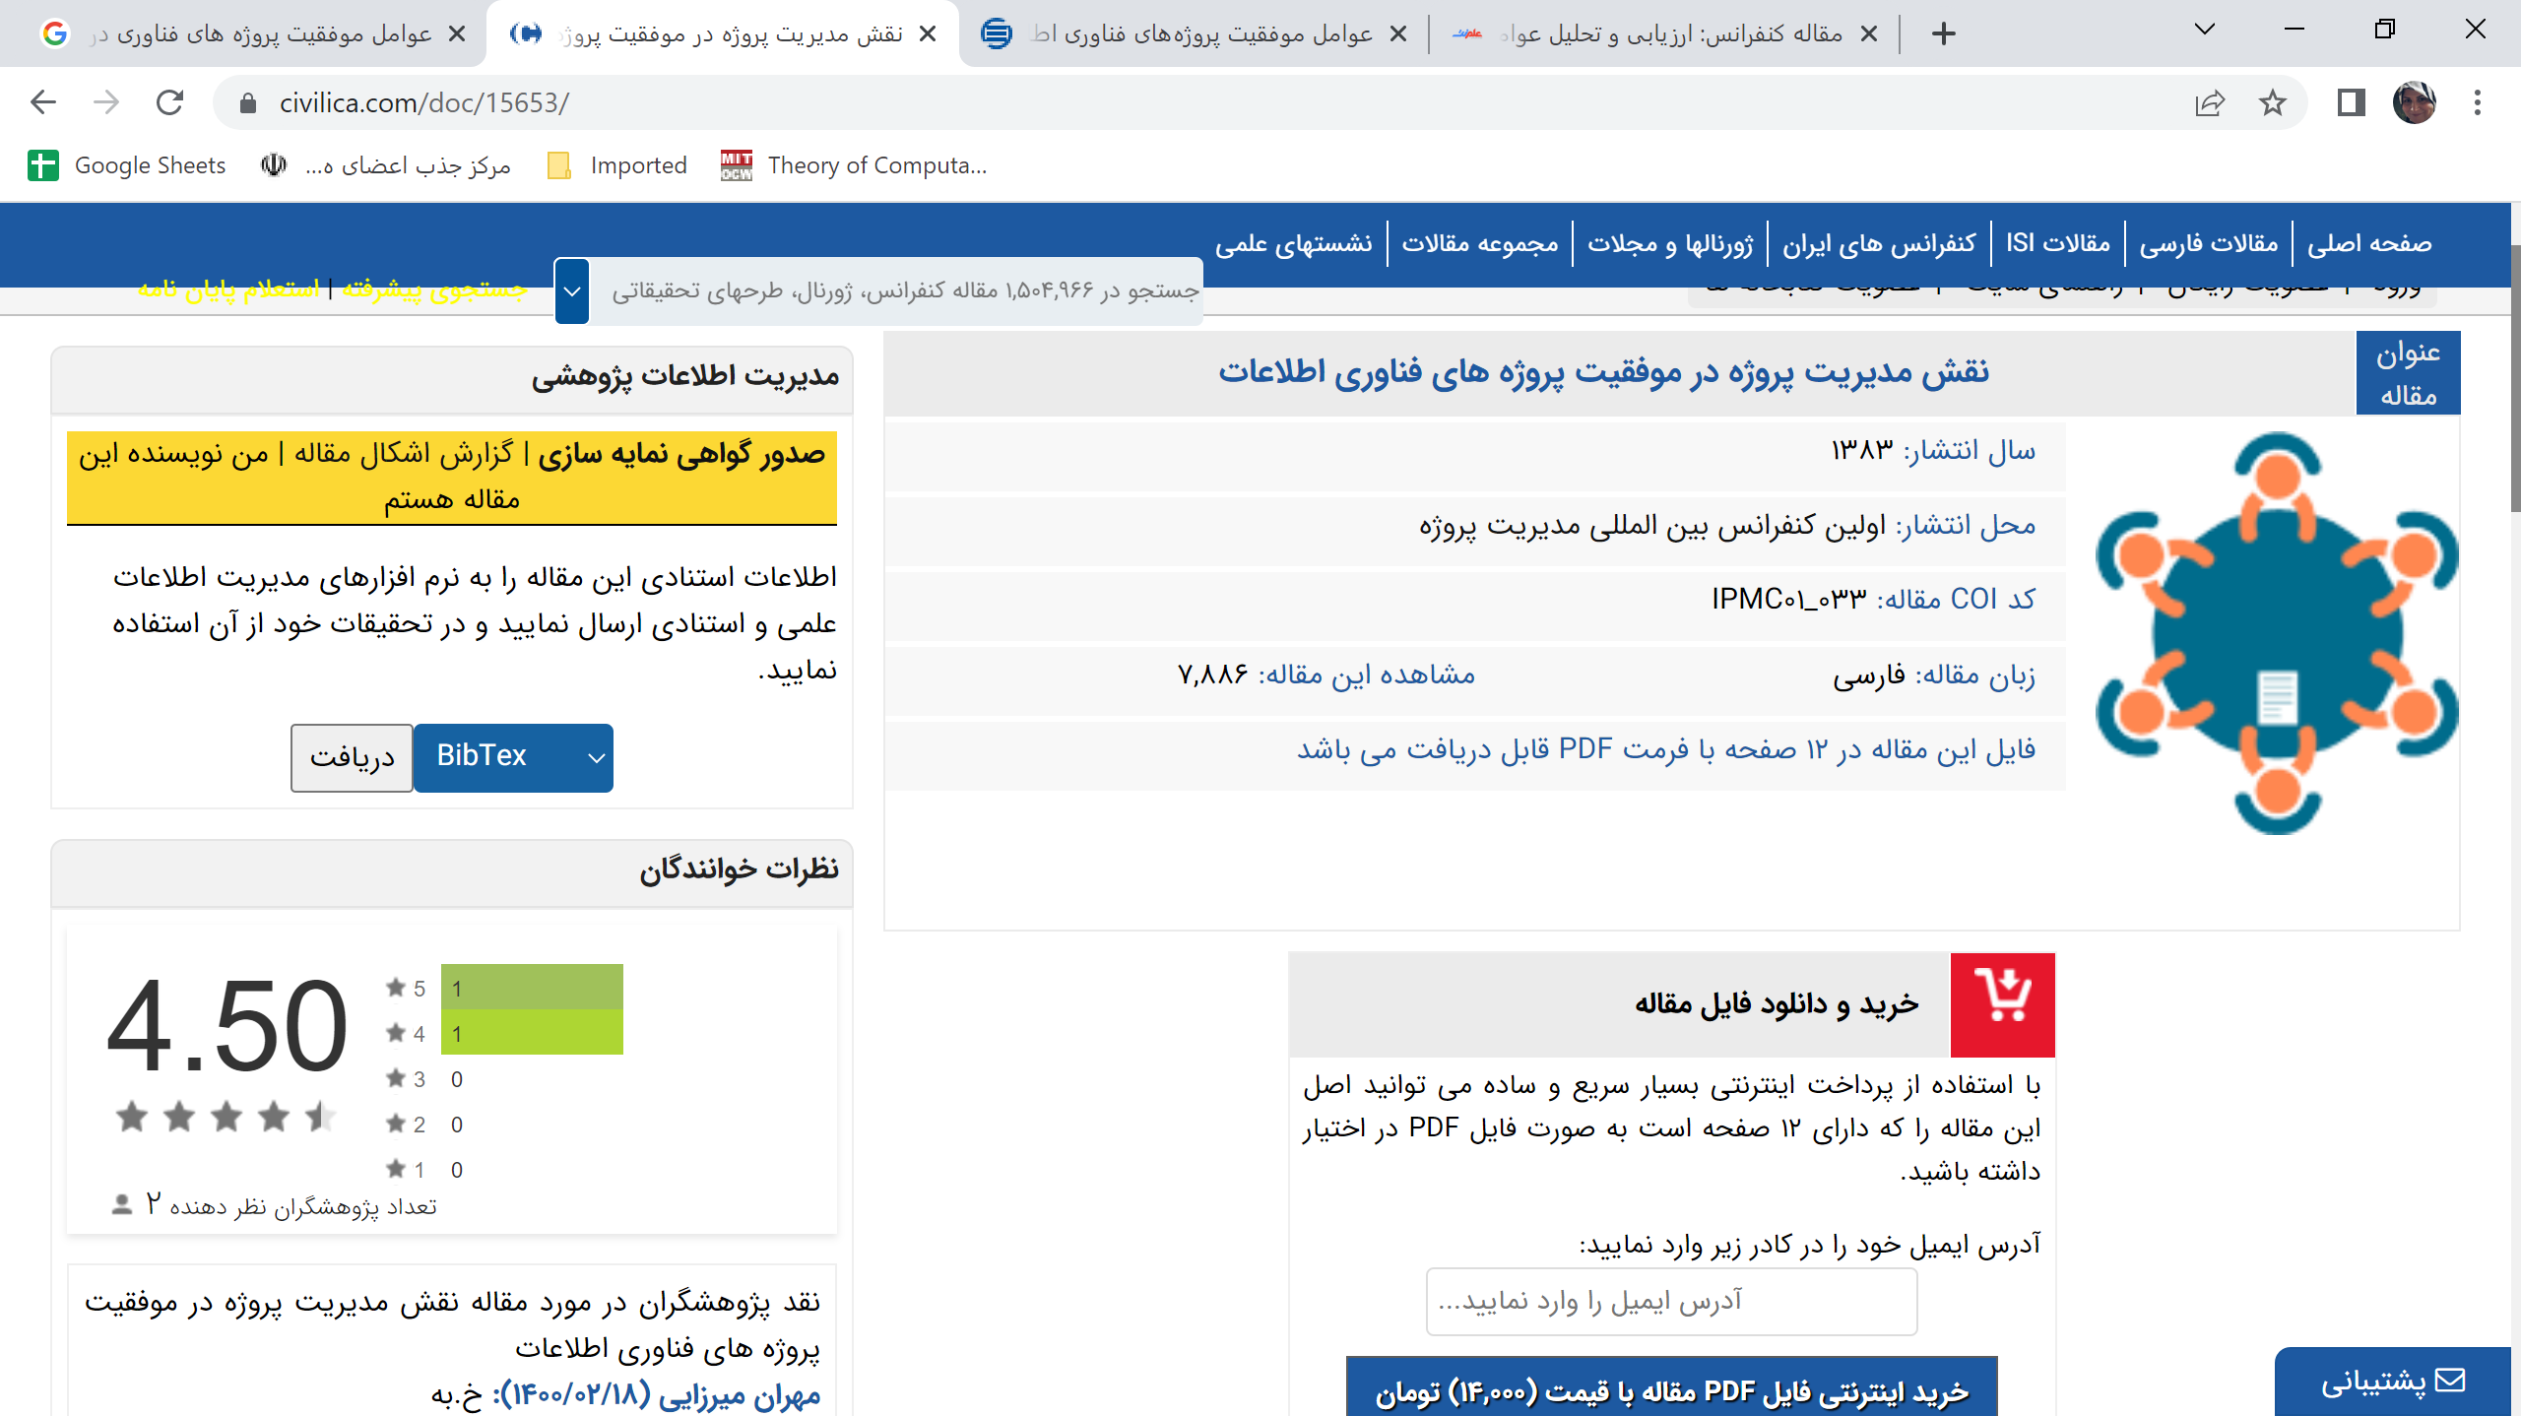
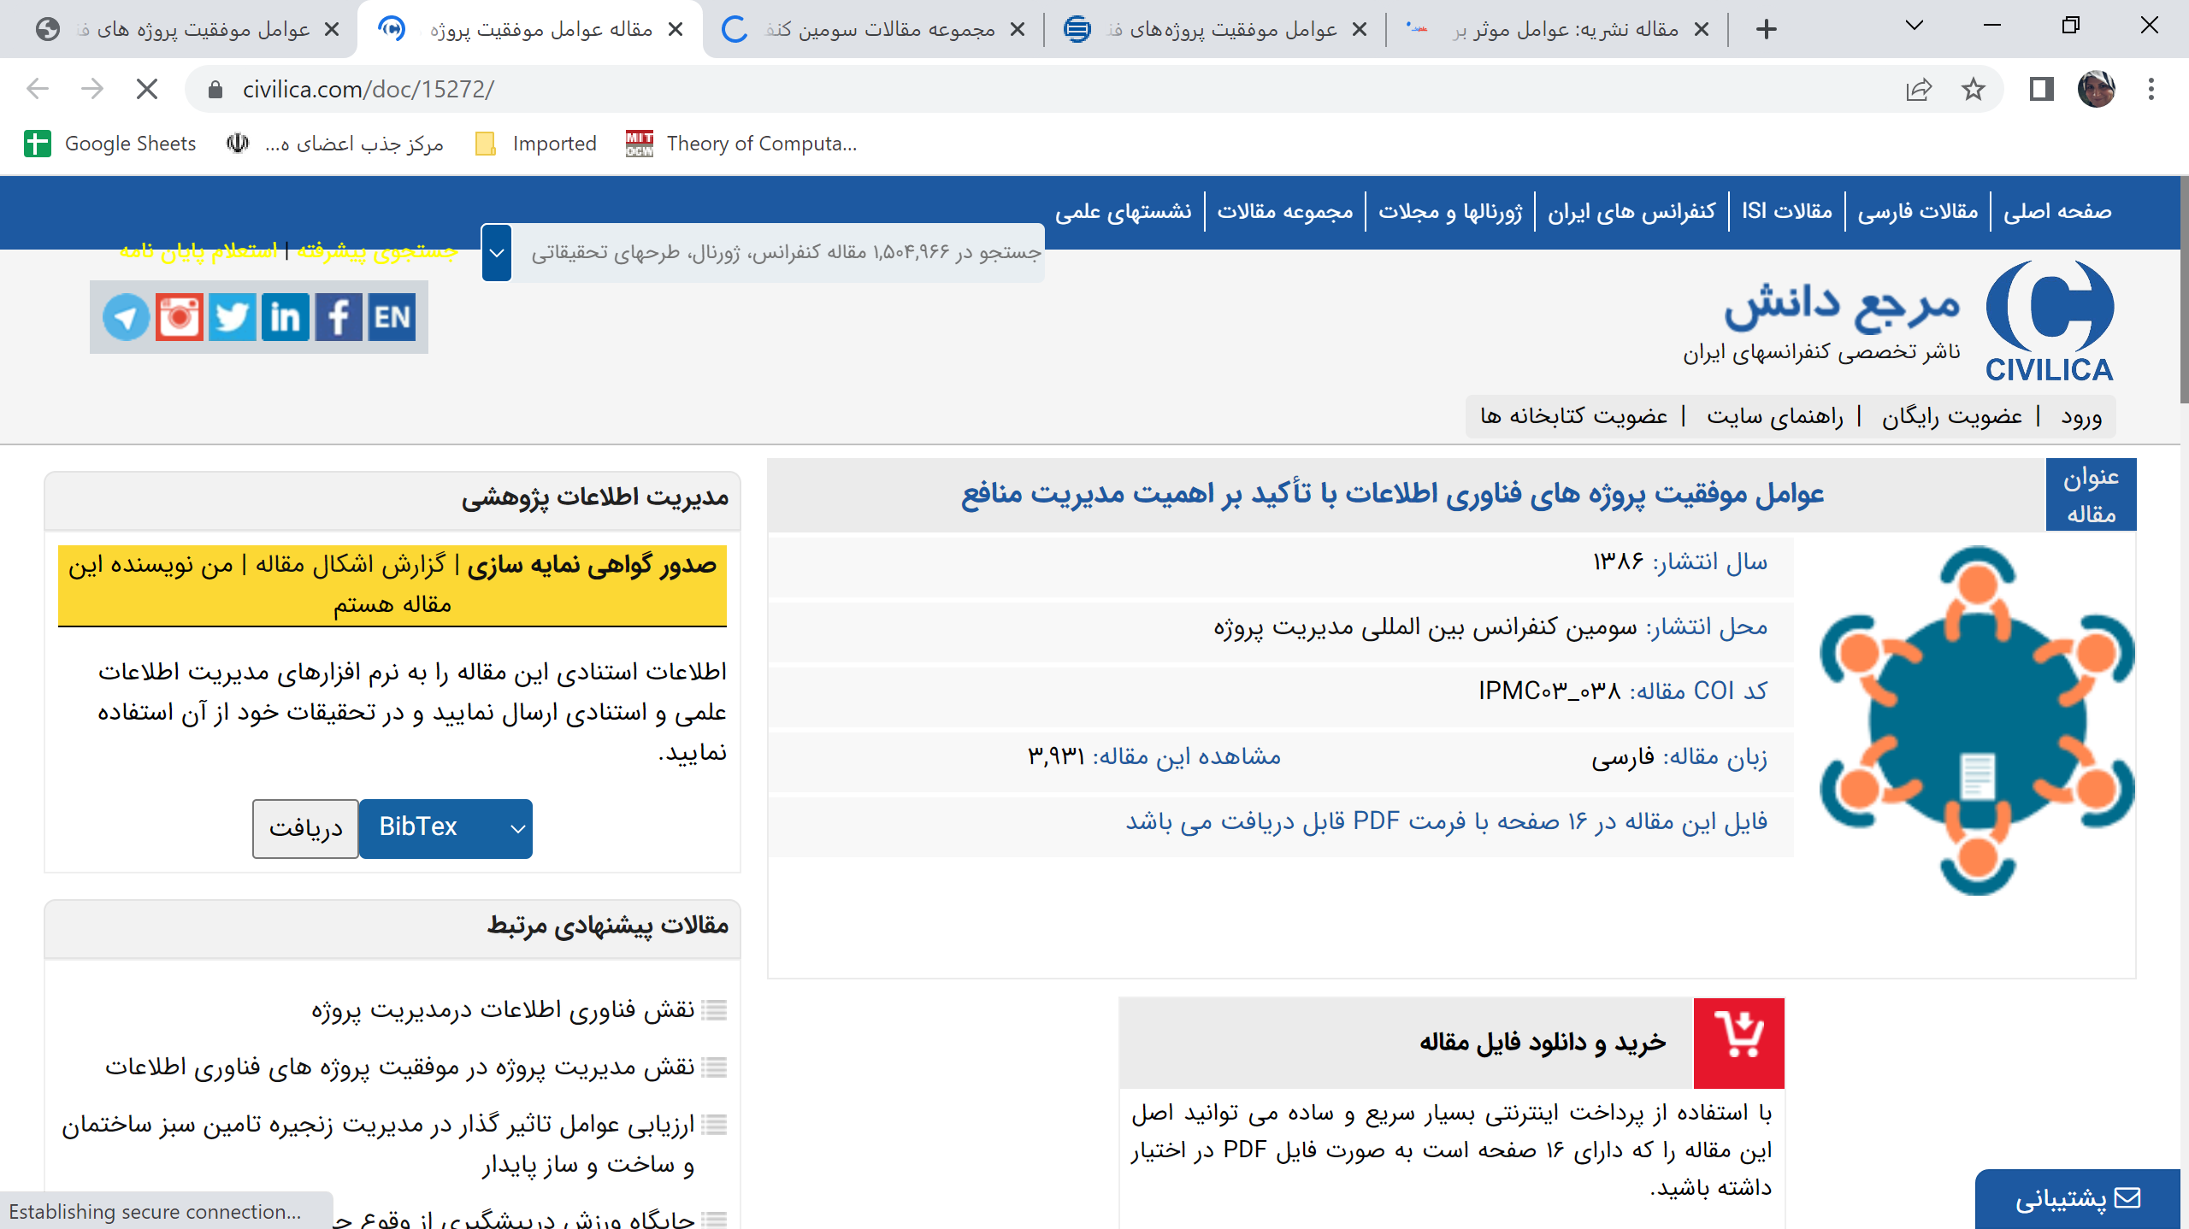
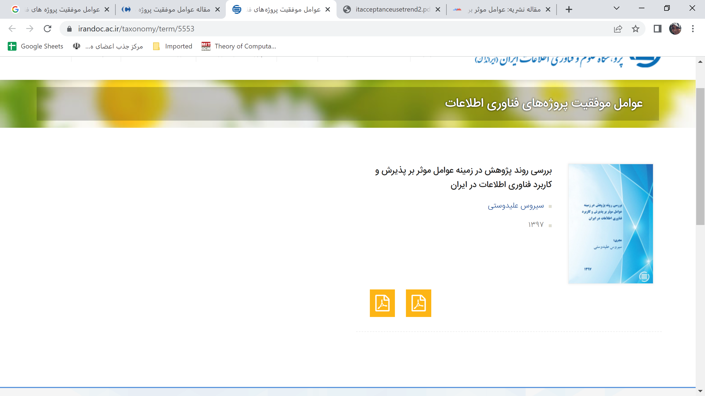
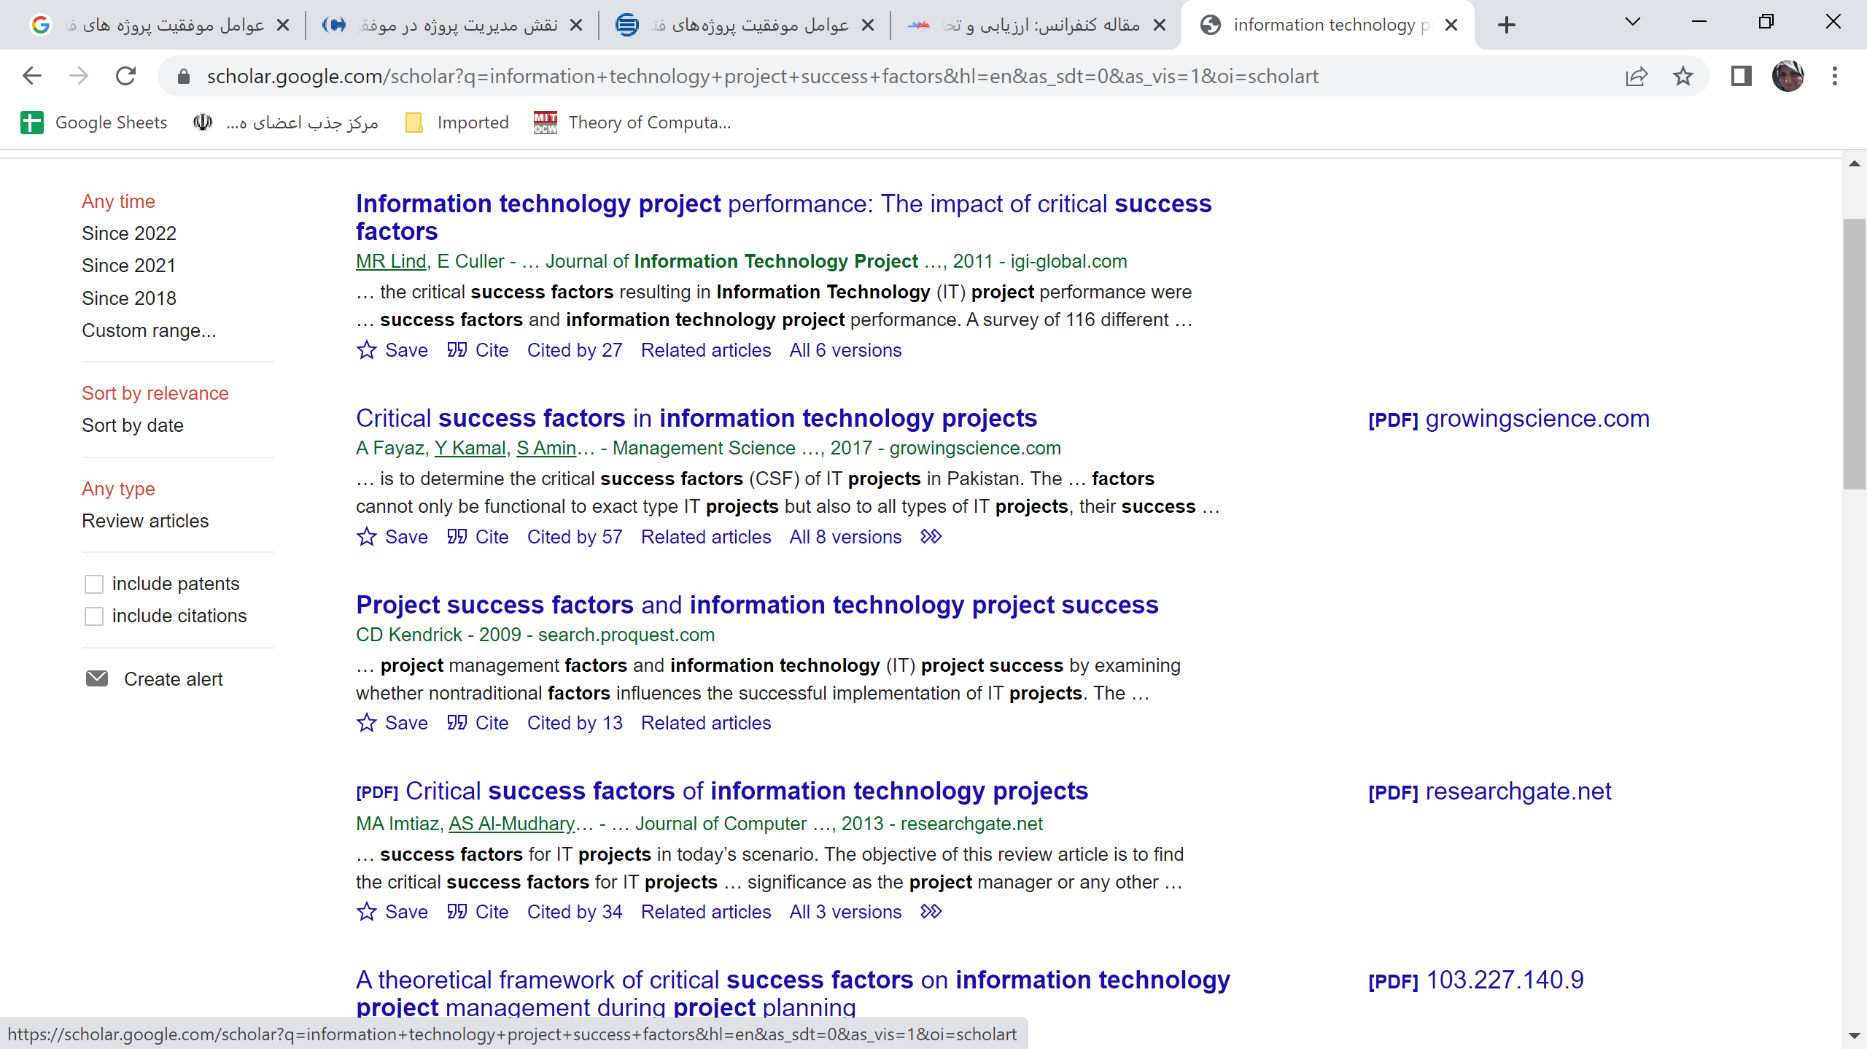
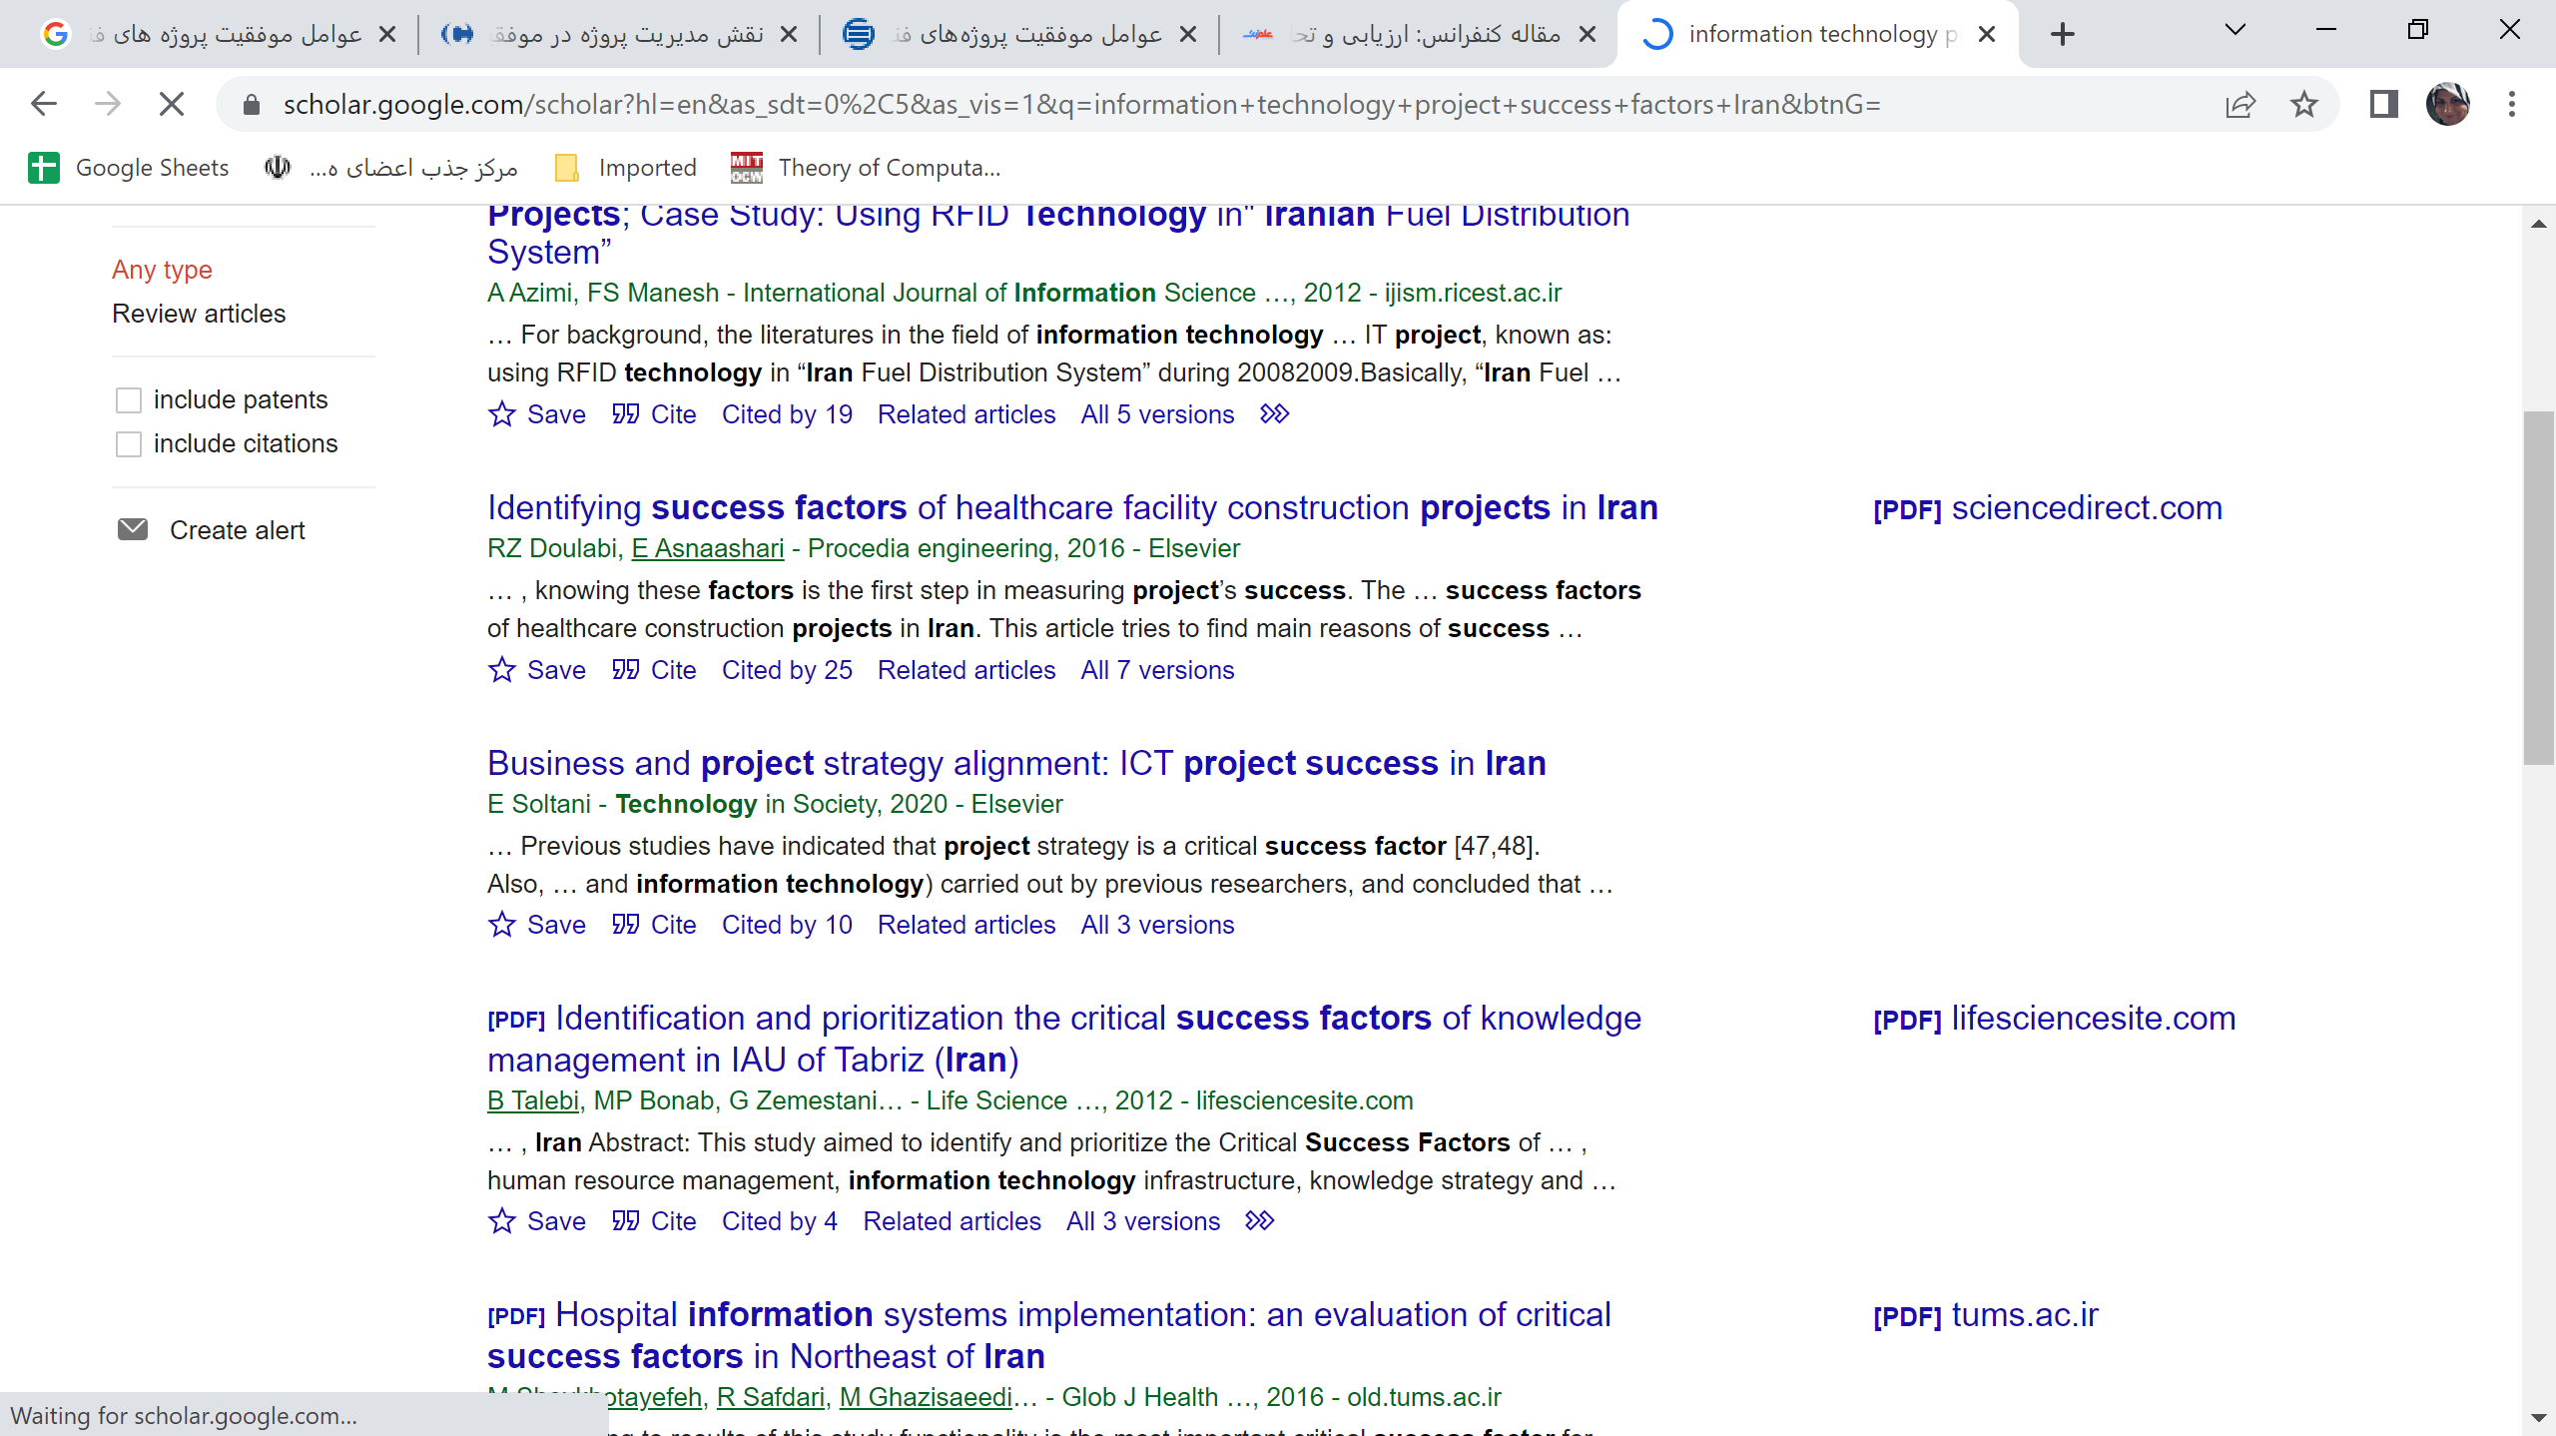
نمونه مقالات مرتبط

Slide 31
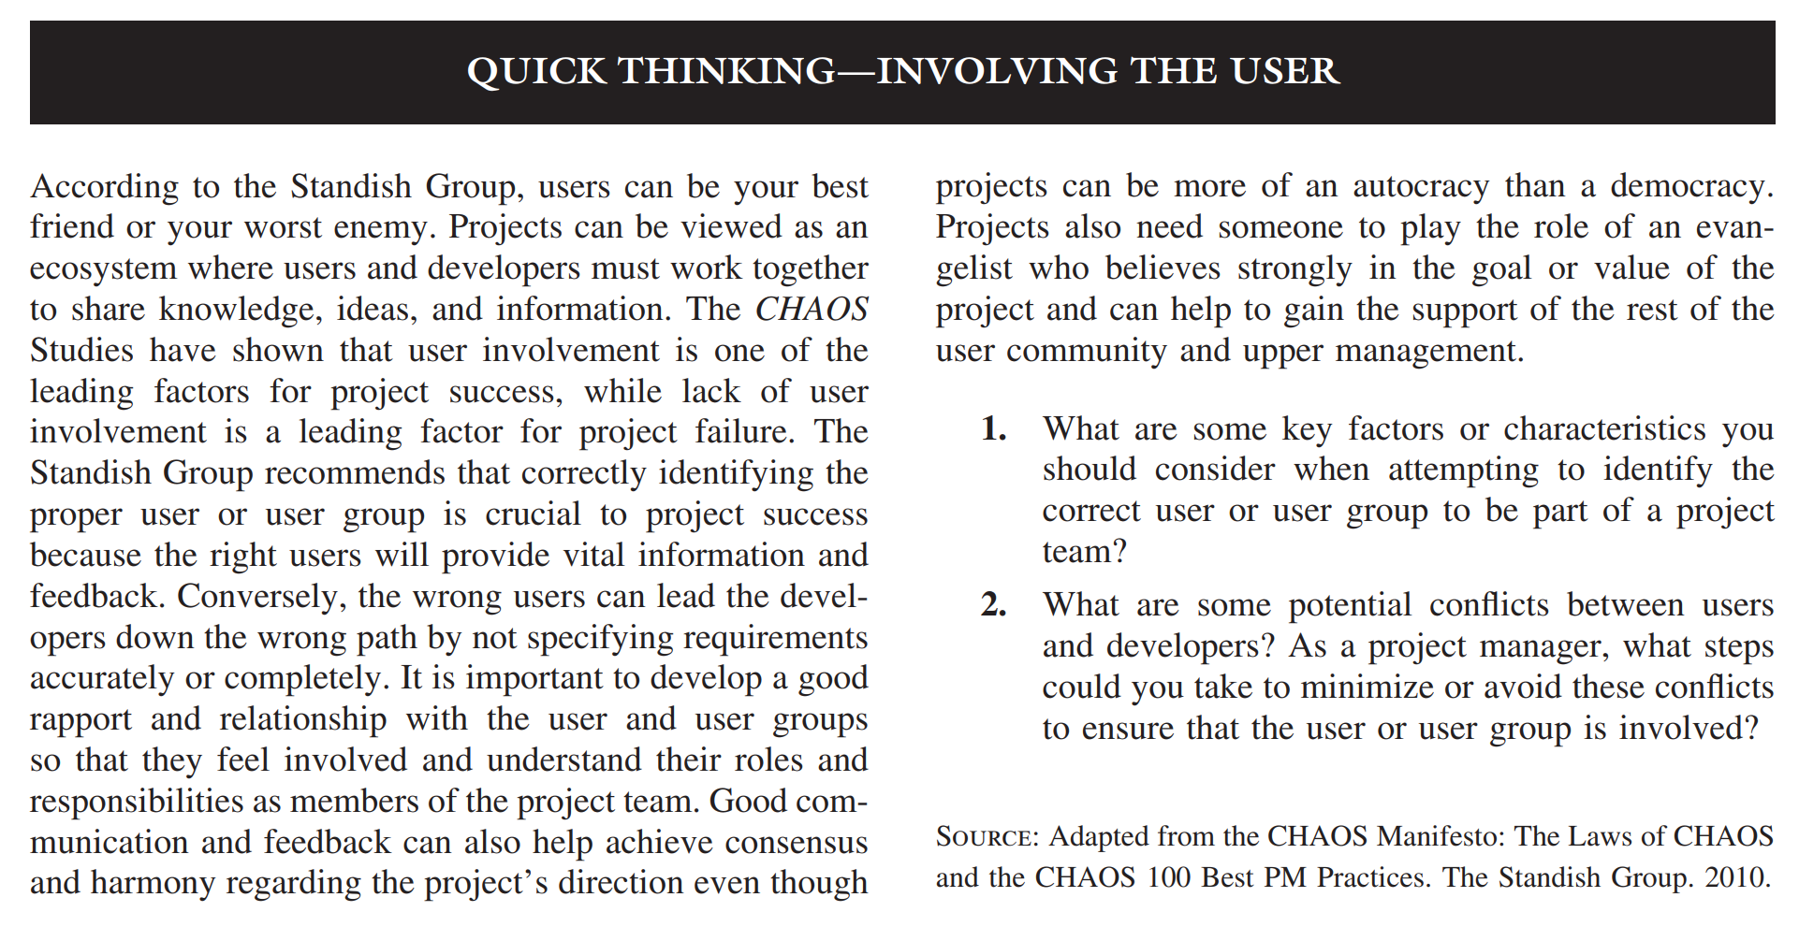

Slide 32

افزایش احتمال موفقیت پروژه های فا
روش مبتنی بر ارزش
روش اجتماعی- فنی
روش مدیریت پروژه
روش مدیریت دانش
Notes:
حالا چطور احتمال موفقیت پروژه فا را افزایش بدهیم =؟ این چهار روش اصلی هستند که در این درس بهش پرداخته میشود

Slide 33
روش مبتنی بر ارزش
ایا تعریف موفقیت پروژه در غالب بودجه و زمانبندی کفایت می کند؟
اگر هدف اماده کردن یک پکیج مدیریت ارتباط با مشتری طی شش ماه و با هزینه 50 میلیون تومان باشد،
اکر شش ماه و یک روز طول کشید چه؟ 52 میلیون هزینه شد چه؟ نقطه شکست پروژه در چه مقادیری تعریف میشود
ایا اتمام پروژه با بودجه ای کمتر و در زمانی کمتر به معنای موفقیت پروژه هست ؟
اگر پروژه های فناوری اطلاعات نوعی سرمایه گذاری هستند چه ارزش قابل اندازه گیری ای به سازمان میدهند تا در مقابل هزینه پول و زمان صرف آن کرد ؟
تعریف موفقیت پروژه؟ زمان، بودجه؟ ( کافی یا لازم؟)
نقطه شکست پروژه چیست؟
ارزش پروژه برای سازمان چه خواهد بود؟
نمونه ارزش های قابل اندازه گیری سازمانی :
خدمات بهتر به مشتریان
هزینه های کمتر
افزایش سهم بازار
موفقیت پروژه باید در قالب ارزشی که برای سازمان خلق می کند تعریف شود.
نتیجه این روش کاهش فشار بر ذی نفعان پروژه برای تعیین بودجه و زمانبندی غیر واقعی است، چون ارزش پروژه معیاری حقیقی از موفقیت است
Notes:
ایا تعریف موفقیت پروژه در غالب بودجه و زمانبندی کفایت می کند؟
اماده کردن یک پکیج مدیریت ارتباط با مشتری طی شش ماه و با هزینه 50 میلیون تومان
اکر شش ماه شد شش ماه و یک روز چه ؟ 52 میلیون هزینه شد جه؟ نقطه شکست پروژه در چه مقادیری تعریف میشود
ایا اتمام پروژه با بودجه ای کمتر و در زمانی کمتر به معنای موفقیت پروژه هست ؟
اگر پروژه های فناوری اطلاعات نوعی سرمایه گذاری هستند چه ارزش قابل اندازه گیری ای به سازمانی میدهند تا در مقابل هزینه پول و زمان صرف آن کرد ؟
نتیجه این روش کاهش فشار بر ذی نفعان پروژه برای تعیین بودجه و زمانبندی غیر واقعی است، چون ارزش پروژه معیاری حقیقی از موفقیت است

Slide 34
روش اجتماعی- فنی
Technical Issues
Social Issues
توجه یکسان به بعدهای سازمانی و فنی
نرم افزارهای حوزه تجارت الکترونیک، مدیریت زنجیره تامین و یکپارچه سازی نیازمند توجه یکسان به هردو بعد هستند.
روزهای آسان سفارش گرفتن تمام شده است.
به دنبال کاربران باشید و آنها را به مشارکت فعال تشویق کنید.
مسئولیت یکسان توسعه دهندگان و کاربران در پیاده سازی موفق پروژه فا.
متخصصان هم باید کسب و کار را بفهمند و در استفاده از فناوری برای ارزش آوری سازمانی خلاقانه فعال باشند.

Slide 35
روش مدیریت پروژه
هنوز برخی بدون طرح اولیه سیستم اطلاعاتی تولید می کنند.
به کارگیری دانش مدیریت پروژه باید بخشی از یک متدولوژی باشد.
متدولوژی: مجموعه ای از فعالیت های گام به گام، فرایند ها و ابزار ها و استانداردهای کیفی ،کنترل ها و اقلام تحویل دادنی که برای کل پروژه تعریف شده اند.
علل استفاده از مدیریت پروژه در حمایت از پروژه های فا:
محدودیت منابع
انتظارات بالای مشتریان- انتظار تحویل محصولات با کیفیت در حوزه فا و به صورت حرفه ای
رقابت بالا( برون سپاری)- هیچ وقت سطح رقابت داخلی و خارجی چنین بالا نبوده است( امکان برون سپاری)
کارآمدی(: روش صحیح) و اثربخشی ( کار صحیح): پذیرش مدیریت پروژه در سازمان در طی زمان منجر به افزایش کارآمدی و اثربخشی می شود.
Notes:
چه کسی در تیم باشد یا نباشد و چرا ؟ موفقیت یا عدم موفقیت پروژه های فا وابستگی زیادی به تعیین تیم پروژه دارد
در نتیجه موفقیت پروژه
منابع سازمان محدود است و پروژه فناوری اطلاعات منابع دیگر پروژه ها میگیرد

Slide 36

روش مدیریت دانش
مدیریت دانش فرآیندی سیستماتیک
برای کسب، خلق، تولید، تبادل و استفاده از
اطلاعات، بینش و تجربیات
جهت تبدیل ایده ها به ارزش های سازمانی است.
معمولا تجربیات تکه تکه در بخش های مختلف سازمان هستند و باید شانس بیاوری تا کسی را در سازمان پیدا کنی که تجربه کاری مشابه داشته باشد.
استفاده بهینه از زمان و تجربیات
جمع آوری قطعات دانش از قسمتهای مختلف سازمان
درسهای تجربیات قبلی
بهترین تجربه ها
هدف:
اطلاعات صحیح
به فرد صحیح
در زمان مناسب

Slide 37
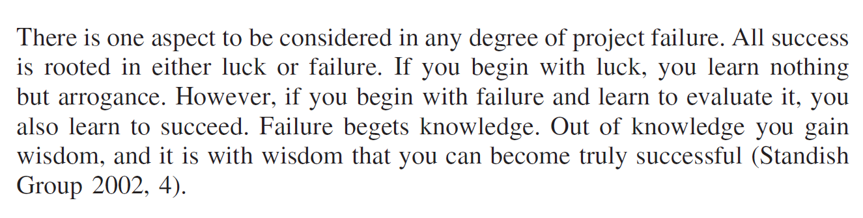

Slide 38

یک پروژه چیست؟
PMI( Project management Institute):
Project is a temporary endeavor undertaken to accomplish a unique product, service or result.
تلاشی
منحصر به فرد
موقت
زمان شروع و پایان معین
با هدف تحویل یک محصول یا خدمت معین یا تغییر آن است.
Things that we do (or work that we do) which is routine and regular are not projects. Things that repeat for ever, are not projects. But, things that are done towards a one-time effort, done seeking a specific outcome are projects.
Notes:
Things that we do (or work that we do) which is routine and regular are not projects. Things that repeat for ever, are not projects. But, things that are done towards a one-time effort, done seeking a specific outcome are projects.

Slide 39
ویژگی های پروژه چیست؟
بازه زمانی ( شروع و پایان)
هدف (مثال: سیستم، نرم افزار، پیشنهاد،...) هدف باید ملموس باشد، دارای ارزش مشخص برای سازمان باشد، هدف باید قدرت تعیین مسیر، بودجه و زمانبدی را داشته باشد، واضح باشد، مورد توافق باشد، مشخص و قابل اندازه گیری باشد.
مالک ( ذی نفعان پروژه متعدد هستند اما پروژه حامی مالی مشخصی باید داشته باشد. این حامی مالی می تواند مدیر اجرایی، کاربر نهایی، مشتری ای باشد که تمایل به جهت دهی، تامین مالی و تامین دیگر منابع برای پروژه دارد.)
منابع( زمان، پول، انسان، فناوری) منابع راه رسیدن به پروژه و محدودیت های آن را تعیین می کنند. الان نیروی فا گران تر از سیستم های فا هستند
نقش( مدیر، مالک، متخصص فنی و غیر فنی)
ریسک و فرضیات (ریسک های داخلی، ریسک های خارجی و فرضیاتی که بر اساس آنها حوزه، هزینه و زمانبندی مشخص میشود).
فعالیت های وابسته (زیرساخت و پیش نیازها، جزییات پیش رونده و رشد پیچیدگی)
تغییر سازمانی ( پروژه ها تغییرات سازمانی هستند و ممکن است با مقاومت نیروهای انسانی مواجه شوند.)
عمل کردن در محیطی بزرگتر از خود پروژه( مدیر پروژه باید درک صحیحی از فرهنگ سازمانی، سیاست ها، علایق و محیط پروژه اش داشته باشد و برای هر محیطی متناسب با همان محیط عمل کند.)

Slide 40
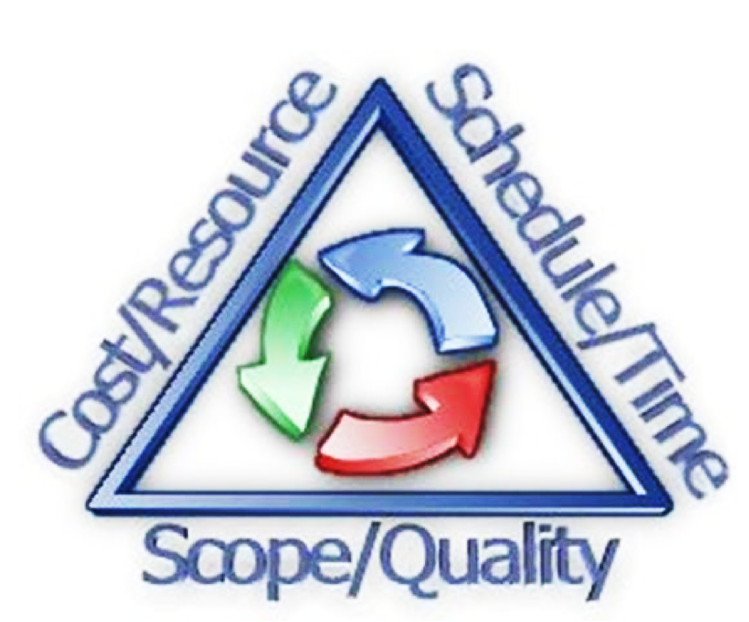
مثلث محدودیت های مدیریت پروژه
این مثلث را هنگام تصمیم گیری در موارد موثر بر حوزه های زمان، بودجه و محدوده و اهداف پروژه بایستی در نظر گرفت

Slide 41
مدیریت پروژه حداکثری
Extreme Project Management (XPM)
علم و هنر دادن امکانات و مدیریت جریان احساسات و تعاملات برای تولید خروجی ارزشمند در شرایط پیچیده ( سرعت بالا، تغییرات زیاد، عدم قطعیت و استرس زیاد)
روشهای سنتی مبتنی بر انطباق واقعیت های بازار با ابزارهای موجود
غالب پروژه های فعلی ثابت و قابل پیش بینی نیستند. سعی داریم در XPM با افزایش انعطاف پذیری و تطابق با آنها رو به رو شویم.
نگاه کلی به برنامه ریزی دارد.
یک قاعده کلی آن تغییر نیازمندی هاست به همین دلیل برنامه ریزی فرآیندی خوداصلاحی و چرخشی دارد.
قاعده دیگر آن نوآوری نه تنها در ایده محصول بلکه در فرآیندها، روشها و ابزارهاست.
افکار، احساسات و تعاملات انسانها به عنوان کاتالیزور برای خلق ایده هاست.
به همین دلیل تمرکز رهبران XPM بر توانمندسازی افراد برای کشف بهترین راهکارها و اصلاح به موقع از جانب آنهاست.
در عین پذیرا بودن ایده های جدید باید فهمی از روش های گذشته برای ساخت چارچوب اولیه داشته باشیم.

Slide 42

روش برخورد با الگوها و روش های متنوع مدیریت پروژه
جعبه ابزاری برای مدیریت پروژه از قبل داریم، در عین حال آموزه ها و ابزارهای جدید را هم در آن قرار میدهیم.
در عین پذیرا بودن ایده های جدید، باید فهمی از روش های گذشته برای ساخت چارچوب اولیه پروژه داشته باشیم.
Notes:
جعبه ابزاری برای مدیریت پروژه از قبل داریم در عین حال آموزه ها و ابزارهای جدید را هم در آن قرار میدهیم.
در عین پذیرا بودن ایده های جدیدباید فهمی از روش های گذشته برای ساخت چارچوب اولیه پروژه داشته باشیم

Slide 43

PMBOK (Project Management Body of Knowledge)
PMI
تعریف 9 حوزه دانش برای فهم مدیریت پروژه
بیان یکسری قواعد بر اساس تجربیات قبلی
افراد زیادی در طی زمان به کارایی این قواعد معتقدند.
قواعدی که برای سازمان ایجاد ارزش می کند.
PMP(Project Management Professional)

Slide 44
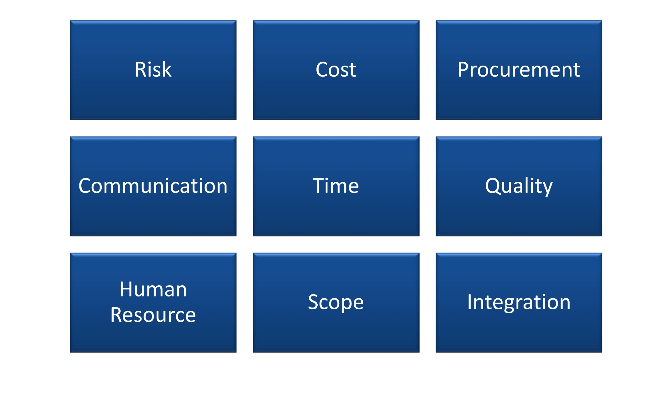
PMBOK
اطمینان از هزینه های پروژه
شناسایی و پاسخگویی مناسب به ریسک های پروژه
اطمینان از تامین مناسب منابع مورد نیاز از خارج از سازمان
فراهم کردن امکان ارتباط در زمان مناسب و انتقال اطلاعات دقیق پروژه به ذی نفعان پروژه
طراحی، توسعه و مدیریت کیفی برای رسیدن به انتظارات و نیازهای ذی نفعان
ساخت و توسعه تیم پروژه و فهم و پاسخگویی به جنبه های رفتاری مدیریت پروژه
هماهنگی طرح توسعه پروژه، اجرا و مدیریت آن
توسعه کنترل و مدیریت زمانبندی،
شناسایی فازها و فعالیت ها،
تخمین توالی و تخصیص منابع برای
اطمینان از رسیدن به اهداف پروژه
تعریف کامل و دقیق کار،
تعریف فرآیندهای تغییر حوزه
Notes:
مدیریت زمان:توسعه کنترل و مدیریت زمانبندی،
شناسایی فازها و فعالیت ها،
تخمین توالی و تخصیص منابع برای
اطمینان از رسیدن به اهداف پروژه
مدیرت دامنه:
تعریف کامل و دقیق کار،
تعریف فرآیندهای تغییر حوزه
مدیرت یکپارچگی:هماهنگی طرح توسعه پروژه،
اجرا و مدیریت آن
مدیریت هزینه پروژه:
اطمینان از هزینه های پروژه
مدیرت کیفیت پروژه:
طراحی، توسعه و مدیریت کیفی برای رسیدن به انتظارات و نیازهای ذی نفعان
مدیریت منابع انسانی پروژه
ساخت و توسعه تیم پروژه و فهم و پاسخگویی به جنبه های رفتاری مدیریت پروژه
مدیریت ارتباطات پروژه
فراهم کردن امکان ارتباط در زمان مناسب و انتقال اطلاعات دقیق پروژه به ذی نفعان پروژه
مدیریت ریسک پروژه
شناسایی و پاسخگویی مناسب به ریسک های پروژه
مدیریت تامین
اطمینان از تامین مناسب منابع مورد نیاز از خارج از سازمان

Slide 45
پایان فصل اول

Slide 46
بررسی تکالیف گروهی
زمان ملاقات تنها 2 ساعت در هفته قطعا کافی نخواهد بود.
تیم تک نفره معنایی ندارد.
عدم بیان چالش های محتمل و راهکار برای حل آنها .
نگاه عمیق تر به مساله و لحاظ کردن ابعاد انسانی محتمل در ادامه جریان پروژه.
تقسیم مناسب وظایف تیمی.
دقت در نحوه تایپ، نگارش متن، یکسان سازی اعداد متن، تنظیم اندازه خطوط،فونت مناسب فارسی و انگلیسی و اندازه مناسب فونت «این سند نشان دهنده شخصیت تیم شماست»
تعیین مدیر گروه در سند و تعیین و تقسیم مجموعه وظایف تیمی.
در پایان هر سند درصد مشارکت اعضا بایستی توسط مدیر تعیین گردد.
زمان های حضور و فعالیت تیم مشخص و دقیق باشند.
تجارب و ارزش ها کپی شده نباشند.

Slide 47
ویژگی های پروژه چیست؟
بازه زمانی ( شروع و پایان)
هدف (مثال: سیستم، نرم افزار، پیشنهاد،...) هدف باید ملموس باشد، دارای ارزش مشخص برای سازمان باشد، هدف باید قدرت تعیین مسیر، بودجه و زمانبدی را داشته باشد، واضح باشد، مورد توافق باشد، مشخص و قابل اندازه گیری باشد.
مالک ( ذی نفعان پروژه متعدد هستند اما پروژه حامی مالی مشخصی باید داشته باشد. این حامی مالی می تواند مدیر اجرایی، کاربر نهایی، مشتری ای باشد که تمایل به جهت دهی، تامین مالی و تامین دیگر منابع برای پروژه دارد.)
منابع( زمان، پول، انسان، فناوری) منابع راه رسیدن به پروژه و محدودیت های آن را تعیین می کنند. الان نیروی فا گران تر از سیستم های فا هستند
نقش( مدیر، مالک، متخصص فنی و غیر فنی)
ریسک و فرضیات (ریسک های داخلی، ریسک های خارجی و فرضیاتی که بر اساس آنها حوزه، هزینه و زمانبندی مشخص میشود).
فعالیت های وابسته (زیرساخت و پیش نیازها، جزییات پیش رونده و رشد پیچیدگی)
تغییر سازمانی ( پروژه ها تغییرات سازمانی هستند و ممکن است با مقاومت نیروهای انسانی مواجه شوند.)
عمل کردن در محیطی بزرگتر از خود پروژه( مدیر پروژه باید درک صحیحی از فرهنگ سازمانی، سیاست ها، علایق و محیط پروژه اش داشته باشد و برای هر محیطی متناسب با همان محیط عمل کند.)

Slide 48


راه های ارتباطی
سامانه یکتا
h.safaeipour@iut.ac.ir
h.safaeipour@gmail.com

